Slide 1
AI Governance for GenAI in the Microsoft Stack
A technical narrative: controls, architectures, baselines, and operational runbooks
Synthesised from two February 2026 technical reports. Designed for engineering, security, and compliance leaders.
AI Governance — Microsoft Stack + GenAI
1/102
Notes:
Sources: (1) AI Governance in the Microsoft Stack (20pp), (2) Technical analysis of AI governance for generative AI (23pp).

Slide 2
How to read this deck
• This is a “governance-as-engineering” deck: decision rights + executable controls + measurable evidence.
• We cover both: (a) generic GenAI governance primitives, and (b) Microsoft-stack implementations (Foundry/Copilot/Purview/Defender/Sentinel).
• Every control is framed as: what it prevents, where it is enforced, and what evidence proves it works.
• Appendix includes full page captures of both source PDFs for completeness and auditability.
AI Governance — Microsoft Stack + GenAI
2/102
Notes:
Deck goal: be detailed enough that engineering teams can implement from it, and governance teams can audit it.

Slide 3
Agenda
• Why GenAI governance is different (incident-driven, system-level risks).
• Governance architecture: Build → Run → Observe control plane.
• Core governance primitives: inventory, tiering, eval gates, policy-as-code, logging, supply chain, incident response.
• Microsoft stack: how Entra, Purview, Defender, Sentinel, Azure Policy, Foundry, Copilot fit together.
• Reference patterns: Azure LLM apps and Microsoft 365 Copilot/agents.
• Baselines + checklists + IaC patterns; operational runbooks; known gaps and mitigations.
• Standards/regulatory landscape (2024–2026) + roadmap to “top 1%” operational capability.
AI Governance — Microsoft Stack + GenAI
3/102
Notes:
Audience: platform engineering, app teams, SOC, risk/compliance. Use section headers as stopping points.

Slide 4
1) Why Governance Now
GenAI turns “model risk” into “system risk”: data + tools + context.
AI Governance — Microsoft Stack + GenAI
4/102

Slide 5
Working definition (GenAI)
• AI governance = organisational governance + technical assurance.
• Organisational: roles, decision rights, accountability, assurance obligations.
• Technical: measurement, control, traceability mechanisms that make obligations testable/auditable.
• For GenAI, behaviour is prompt-programmable and context-dependent; risks often enter outside the model weights (RAG, tools, permissions).
AI Governance — Microsoft Stack + GenAI
5/102
Notes:
Source: GenAI governance report p.1–2. Key framing: governance must be end-to-end, not “model-only”.

Slide 6
Regulatory/standards shift (2024–2026): what changed
• EU AI Act entered into force (2024) with phased obligations; GPAI obligations apply from Aug 2025; broad applicability Aug 2026.
• US OMB Memo M-24-10 (Mar 2024) sets minimum governance practices for federal agencies (risk management, accountability).
• UN GA (2024) resolution emphasizes “safe, secure, trustworthy” AI and international cooperation on safeguards.
• Standards are converging on management-system + risk + testing: ISO/IEC 42001, ISO/IEC 23894, and explicit AI testing series.
AI Governance — Microsoft Stack + GenAI
6/102
Notes:
Source: GenAI report pp.1,9–13. Use this slide to justify why “paper policies” are no longer defensible.

Slide 7
Incidents that map directly to missing controls
• Chatbot misrepresentation → legal liability (Air Canada tribunal): org remains responsible for AI output on its website.
• Image-generation safety failure → feature paused (Gemini, Feb 2024): naive global safety tuning creates new failure modes.
• AI voice deepfakes used for election robocalls → enforcement actions: authenticity/provenance becomes a governance requirement.
• Lesson: governance must be technical (grounding, evals, monitoring, provenance), not aspirational.
AI Governance — Microsoft Stack + GenAI
7/102
Notes:
Source: GenAI report p.2–3. “Incident class → missing control” is the persuasion pattern.

Slide 8
The #1 GenAI application failure mode: indirect prompt injection
• In RAG/agent systems, untrusted content (emails/docs/web pages) becomes part of the model’s programmable surface.
• Attack: embed malicious instructions in retrieved content; model ingests and follows them without direct attacker access to the prompt UI.
• Implication: treat retrieval corpora + tool inputs like untrusted code → sandbox + least privilege + allow-lists + traceability.
• Operationally: you need detectors (Prompt Shields), tool gating, and red-team regression suites.
AI Governance — Microsoft Stack + GenAI
8/102
Notes:
Source: GenAI report p.3 (CETaS + OWASP risk framing).

Slide 9
2) Governance Architecture
Design an executable control plane across Build, Run, and Observe.
AI Governance — Microsoft Stack + GenAI
9/102

Slide 10
GenAI governance architecture: Build → Run → Observe (control plane)
BUILD & CHANGE CONTROL
• Use-case registration + risk tiering
• Data governance: lineage, consent, PII controls
• Model selection / fine-tuning
• Offline eval gate: quality/safety/security/privacy
• Release artefacts: system card + policy package
• Signed supply chain: SBOM/ML-BOM + provenance
RUNTIME CONTROL PLANE
• Prompt & policy gateway
• RAG retrieval + tool router
• Model endpoint
• Output validation & safety layers
• Central logging + audit (prompt/retrieval/tool traces)
CONTINUOUS ASSURANCE
• Monitoring: safety KPIs, misuse, cost, latency
• Incident response: triage, containment, rollback/kill-switch
• Continuous red-teaming + regression tests
• Post-mortems feed back into eval suites + policies
AI Governance — Microsoft Stack + GenAI
10/102
Notes:
Source: Technical analysis of AI governance for generative AI (p. 3–4).

Slide 11
Control-plane primitives (what “good” looks like)
• Complete asset inventory: models, prompts/policies, datasets, retrieval corpora, tools/actions, endpoints, owners.
• Risk tiering by use case: high-impact use cases require heavier gates and stronger runtime constraints.
• Evaluation gates: capability + safety + security + privacy + operational budgets (latency/cost).
• Policy-as-code enforcement at runtime: prompt/policy gateway mediates tool calls and data access.
• High-quality logs/audit trails: prompt, retrieval, tool-call traces; reproducible incident replay.
• Supply-chain integrity: SBOM + provenance attestations; extend toward ML-BOM/AI-BOM.
• GenAI-specialised incident response: rollback/kill-switches; post-incident tests so failures don’t return.
AI Governance — Microsoft Stack + GenAI
11/102
Notes:
Source: GenAI report p.1,4,9,16–19. These primitives map cleanly onto Microsoft stack (Foundry + Purview + Defender + Sentinel).

Slide 12
Asset inventory & AI-BOM (foundation of every other control)
• You cannot govern what you cannot enumerate.
• Minimum inventory for GenAI: model + prompt templates/policies + corpora + tools/actions + endpoints + data classes + change owners.
• 2026 practice trends: move beyond SBOM to ML-BOM/AI-BOM concepts so models/datasets are first-class components.
• Automate inventory in CI/CD: new models/prompts/tools cannot deploy unless registered and risk-tiered.
AI Governance — Microsoft Stack + GenAI
12/102
Notes:
Source: GenAI report p.4–5. Keep inventory friction low or adoption collapses.

Slide 13
Data governance for GenAI: treat RAG corpora as governed datasets
• Most GenAI risk is data risk: sensitive retrieval, poisoned corpora, illegal training data, feedback loops encoding bad values.
• For RAG: classify documents, enforce ACLs at retrieval time, version corpora, and log retrieval results with prompts/responses.
• For fine-tuning: define data admissibility rules (licensing, consent, PII) + dataset documentation (datasheets).
• Trade-off: stronger governance reduces agility; mitigate with automation and “paved roads”.
AI Governance — Microsoft Stack + GenAI
13/102
Notes:
Source: GenAI report p.5. This maps to Purview labels/DLP + retrieval ACL enforcement in Azure AI Search/SharePoint.

Slide 14
Identity, access, and secure tool use: the “blast radius” knob
• Catastrophic failures happen when an LLM can act (tools) or exfiltrate (data).
• Enforce least privilege outside the model: capability-based tool permissions, JIT access, per-session tokens.
• Never let the model hold high-privilege credentials; mediate tool calls via a policy gateway.
• Sandbox tools that parse untrusted content (browsing, file parsing) to limit injection damage.
AI Governance — Microsoft Stack + GenAI
14/102
Notes:
Source: GenAI report p.5–6. In Microsoft stack: Entra + Managed Identity + APIM + tool allow-lists.

Slide 15
Evaluation & red-teaming as code (turn intent into measurable gates)
• GenAI governance needs multi-dimensional evaluation: capability, robustness, safety, security, privacy, and ops performance.
• Maintain suites by risk scenario (jailbreaks, data exfiltration, misinformation, domain-specific harms).
• Run regression gates in CI: no deploy if safety/security KPIs regress above thresholds.
• Use baseline tooling: evaluation harness (Inspect), vulnerability probing (Garak), and test-as-code for prompts/agents/RAG (Promptfoo).
AI Governance — Microsoft Stack + GenAI
15/102
Notes:
Source: GenAI report p.6,16–17. In Microsoft stack: Foundry evaluations + observability + Content Safety signals.

Slide 16
Safety layers: defence-in-depth (alignment is not enough)
• Production safety is a layered stack: pre-prompt policies → input filters → model safety → output filtering → post-processing validation.
• Deploy a versioned “policy package” as code (rules, thresholds, evaluators).
• Measure: refusal rate vs unsafe acceptance; override rate; jailbreak success delta before/after policy changes.
• Treat groundedness as both quality and risk signal in RAG apps.
AI Governance — Microsoft Stack + GenAI
16/102
Notes:
Source: GenAI report p.6–7; Microsoft report p.6–7 (Prompt Shields, groundedness, protected material).

Slide 17
Interpretability & assurance: targeted, not blanket
• Interpretability is becoming partially operational (e.g., feature extraction via sparse autoencoders), but remains expensive/imperfect.
• Use it surgically: audit unsafe tendencies, debug misalignment in critical domains, validate that “steering” is causally effective.
• Governance value: reduce catastrophic tail risk and provide stronger evidence to regulators/partners—budget like security research.
AI Governance — Microsoft Stack + GenAI
17/102
Notes:
Source: GenAI report p.7. Use this slide to resist “interpretability as checkbox” while still acknowledging its role.

Slide 18
Provenance & authenticity (especially for media)
• Provenance standards (C2PA Content Credentials) provide signed claims about asset history and edits.
• Watermarking (e.g., SynthID) embeds signals intended to survive transformations—still attackable; ecosystem adoption uneven.
• Governance should build internal provenance chains regardless: model version + prompt template + policy version + retrieval hashes per output.
• Measure detectability under transformations + false positives/negatives + metadata survival rate.
AI Governance — Microsoft Stack + GenAI
18/102
Notes:
Source: GenAI report p.7–8.

Slide 19
Documentation is a control (not a PDF)
• Model cards, system cards, and datasheets are release artefacts that encode intended use, evaluation results, and limitations.
• Generate documentation automatically from pipelines (metrics, lineage, eval results) and version it like code.
• Documentation freshness is a KPI: stale docs are a governance/supply-chain risk.
AI Governance — Microsoft Stack + GenAI
19/102
Notes:
Source: GenAI report p.8.

Slide 20
DevSecOps + SRE + incident response (GenAI-specific)
• Treat model artefacts (weights/adapters/prompt packages) like deployable binaries: signing + provenance + rollbacks.
• Logs must support incident replay: prompt, policy version, retrieval trace, tool calls, model version pinning.
• Maintain kill-switches for tools and risky scenarios; post-incident, expand eval suites to prevent recurrence.
• Track MTTD/MTTR, reproducibility rate, and change-failure rate for prompt/model updates.
AI Governance — Microsoft Stack + GenAI
20/102
Notes:
Source: GenAI report p.9. This maps to Microsoft guidance on layered controls + monitoring + runbooks.

Slide 21
3) Microsoft Stack: Control Planes
Compose Entra + Purview + Defender + Sentinel + Policy + Foundry + Copilot.
AI Governance — Microsoft Stack + GenAI
21/102

Slide 22
Executive synthesis: Microsoft “built-in” governance is a stack pattern
• Identity + access governance (Entra, RBAC, PIM, Conditional Access).
• Data governance for AI interactions (Purview labels, DLP, audit, eDiscovery, retention; DSPM for AI).
• AI safety guardrails (content filters + prompt injection defences + groundedness/protected material).
• Security posture + threat protection (Defender for Cloud AI SPM + AI threat protection; XDR/Sentinel correlation).
• Observability + monitoring (Foundry observability + App Insights/OpenTelemetry; Azure ML monitoring).
• Operational governance (Copilot Control System + admin centre; connector governance; controlled rollouts; validation tests).
AI Governance — Microsoft Stack + GenAI
22/102
Notes:
Source: Microsoft stack report p.1–2. Core message: governance emerges from composition, not one control plane.

Slide 23
Microsoft-stack AI governance as a layered control system
Identity + Access Governance
Key idea: governance is composition, not a single product
Entra (RBAC, PIM, Conditional Access), Managed Identity
• Foundry = Azure-side fleet governor (guardrail policies + observability).
• Purview = evidence bus (labels/DLP/audit/eDiscovery for AI interactions).
• Defender + Sentinel = posture + detection/response loop.
• Copilot Control System + admin centre = M365 agent/connector governance.
• Azure Policy + IaC = enforce baselines at scale.
Operational takeaway: even “correct” controls can fail (vendor bugs). Treat governance as continuous assurance with detection + verification tests + kill switches.
Data Governance for AI
Purview: labels, DLP, audit, eDiscovery, retention; DSPM for AI
Safety Guardrails
Content filters, Prompt Shields, groundedness, protected material
Security Posture + Threat Protection
Defender for Cloud AI SPM + AI threat protection; XDR/Sentinel
Observability + Monitoring
Foundry observability + App Insights; Azure ML monitoring
Operational Governance
Copilot Control System; connector hygiene; rollout + runbooks + tests
AI Governance — Microsoft Stack + GenAI
23/102
Notes:
Source: AI Governance in the Microsoft Stack (pp. 1–2).

Slide 24
Foundry Control Plane: the Azure-side “fleet governor”
• Microsoft is converging Azure AI governance around “Microsoft Foundry” and Foundry Control Plane.
• Control plane primitives: guardrail policies (minimum safety controls) + operational surfaces integrating Defender for Cloud and Purview.
• Treat Foundry Control Plane as the AI fleet governor for Azure-side agents/models, while Azure Policy remains org-wide enforcement.
• Production pattern: policy-as-code baselines + continuous validation (Defender) + evidence capture (Purview).
AI Governance — Microsoft Stack + GenAI
24/102
Notes:
Source: Microsoft stack report p.1–2,5–7,16. Use this to position Foundry vs Azure Policy vs SOC tooling.

Slide 25
Copilot governance: inherits M365 boundaries but depends on data posture
• Copilot inherits existing M365 security boundaries (permissions, labels, Conditional Access).
• It is only as safe as the underlying data posture: overshared SharePoint sites, weak labeling, unmanaged connectors.
• Copilot Control System + Purview DSPM for AI act as the admin “control tower” for Copilot/agents.
• Governance must include rollout throttles and continuous verification, not “set and forget”.
AI Governance — Microsoft Stack + GenAI
25/102
Notes:
Source: Microsoft stack report p.1–3,5–9.

Slide 26
2026 operational truth: controls can fail due to product defects
• Jan–Feb 2026: Copilot Chat bug (service advisory CW1226324) could summarise confidential-labelled emails (Outlook Drafts/Sent Items).
• Key lesson: layered controls + detection + verification tests are mandatory; not all bypasses are observable at the perimeter.
• Governance programs need kill-switch playbooks: disable/limit features fast while triaging scope.
AI Governance — Microsoft Stack + GenAI
26/102
Notes:
Source: Microsoft stack report p.1,12–13.

Slide 27
Capability inventory: map governance domains to Microsoft surfaces
• Policy enforcement: Azure Policy + Foundry guardrail policies; M365 admin centre controls for Copilot/agents.
• Access control: Azure RBAC + managed identities; Entra admin roles + PIM + Conditional Access.
• Data protection: private endpoints, CMK, encryption; Purview labels/DLP/DSPM; data residency for Copilot stores.
• Monitoring/audit: Azure diagnostics → Log Analytics; Foundry observability; Purview Audit + retention/eDiscovery; Sentinel connectors.
• Lifecycle/change mgmt: Foundry model retirements + evaluations; agent inventory and connector governance.
AI Governance — Microsoft Stack + GenAI
27/102
Notes:
Source: Microsoft stack report p.2–3. Use this slide as a “map legend” for later patterns.

Slide 28
Shared responsibility: assign controls by who can enforce them
• Provider: baseline content filtering, abuse monitoring, and platform primitives (RBAC, audit surfaces).
• Customer platform/security: least privilege design, Conditional Access, PIM, data classification and DLP, posture management, SOC detections.
• App/agent builders: prompt/response validation, tool gating, groundedness checks, safe tool invocation, and telemetry emission.
• Anti-theatre rule: if no one owns the enforcement surface, the control doesn’t exist.
AI Governance — Microsoft Stack + GenAI
28/102
Notes:
Source: Microsoft stack report p.4.

Slide 29
4) Reference Architectures
RAG + agents + governance evidence loops.
AI Governance — Microsoft Stack + GenAI
29/102

Slide 30
Pattern: Azure-side LLM app governance (RAG + tool use + fleet controls)
User / Client
Governance + Evidence
Azure OpenAI / Foundry
Inference
• Azure Policy: baseline enforcement
• Defender for Cloud: AI SPM + threat protection
• Purview: audit, DLP, eDiscovery; DSPM for AI
• Azure Monitor/Log Analytics: diagnostics
• Sentinel: SIEM detections + hunting
• Foundry Control Plane: guardrail policies + fleet ops
API Gateway
(Front Door / APIM)
Azure AI Content Safety
(filters, Prompt Shields, groundedness)
LLM App
(AppSvc / AKS / Functions)
Retrieval Layer (RAG)
Key Vault
AI Governance — Microsoft Stack + GenAI
30/102
Notes:
Source: AI Governance in the Microsoft Stack (p. 4–7).

Slide 31
Azure-side pattern: the key integrations that make it “governable”
• Network isolation: private endpoints for Azure OpenAI; remove public endpoints by default for regulated workloads.
• Identity: prefer Entra + managed identity; avoid secrets; store remaining secrets in Key Vault with logging.
• Safety: combine content filters with Prompt Shields + groundedness detection + protected material detection.
• Telemetry: Azure OpenAI diagnostic settings → Log Analytics; Foundry observability + OpenTelemetry traces for agents/tool calls.
• Evidence & SOC: Purview for auditable prompts/responses; Sentinel for detections/hunting; Defender XDR correlation.
AI Governance — Microsoft Stack + GenAI
31/102
Notes:
Source: Microsoft stack report p.5–7.

Slide 32
Pattern: Microsoft 365 Copilot governance (data readiness + oversharing control)
User
Microsoft 365 Copilot
/ Copilot Chat
Microsoft Graph
+ Semantic Index
Controls that actually move risk
SharePoint / OneDrive
• Sensitivity labels = persistent classification/protection.
• DLP policy location “Microsoft 365 Copilot and Copilot Chat”
→ can block prompts/grounding; propagation delay up to ~4 hours.
• Restricted SharePoint Search = blast-radius throttle during rollout.
• Admin centre: manage agents, connectors, web search, external providers.
• Purview Audit + retention/eDiscovery: prompt/response discoverability.
• SOC loop: Sentinel ingestion + detections + XDR correlation.
Main failure mode: Copilot surfaces what users can access — even if they “shouldn’t” in practice. Fix oversharing first.
Exchange
Teams
AI Governance — Microsoft Stack + GenAI
32/102
Notes:
Source: AI Governance in the Microsoft Stack (p. 5–9, 12).

Slide 33
SOC integration: from “policy definitions” to measurable detections
• Evidence: Purview Audit captures Copilot/AI interactions; retention/eDiscovery preserve investigation trails.
• Ingestion: Microsoft Copilot data connector for Sentinel ingests Copilot logs via the Purview Unified Audit Log (public preview Feb 2026).
• Detection engineering: build alerts on risky AI usage, exfil attempts, policy bypass indicators, anomalous agent usage spikes.
• Outcome: AI governance becomes measurable—governance is not complete until you can detect/triage incidents.
AI Governance — Microsoft Stack + GenAI
33/102
Notes:
Source: Microsoft stack report p.6–7.

Slide 34
5) Baselines, Checklists, IaC
Make governance deployable and testable.
AI Governance — Microsoft Stack + GenAI
34/102

Slide 35
Azure AI workload baseline (minimum viable governance)
• Identity & secrets: managed identities + Entra auth; Key Vault for secrets; log Key Vault operations.
• Network: private endpoints for Azure OpenAI; endpoint restrictions where VNet integration is not supported.
• Safety guardrails: configure content filters; enable Prompt Shields; add groundedness and protected material detection where relevant.
• Monitoring: enable diagnostic settings → Log Analytics; build KQL dashboards and alert rules.
• Posture & threat protection: enable Defender for Cloud AI security posture management + AI threat protection; integrate into XDR.
AI Governance — Microsoft Stack + GenAI
35/102
Notes:
Source: Microsoft stack report p.6–8.

Slide 36
Microsoft 365 Copilot baseline (minimum viable governance)
• Data posture first: sensitivity label taxonomy + adoption plan; remediate oversharing in SharePoint/OneDrive.
• Rollout throttle: Restricted SharePoint Search to limit Copilot/search blast radius during remediation.
• Purview controls: configure DLP policy location for “Microsoft 365 Copilot and Copilot Chat” (test propagation and boundaries).
• Audit/compliance: Purview Audit for AI interactions; retention and eDiscovery specifically for Copilot/AI app data.
• Admin centre governance: explicit agent inventory controls (allow/block/remove) + connector governance; manage web search + external providers.
AI Governance — Microsoft Stack + GenAI
36/102
Notes:
Source: Microsoft stack report p.7–9,12.

Slide 37
Copilot Studio governance = Power Platform governance + AI-specific knobs
• Enforce environment-level data policies (DLP) to control connectors, HTTP requests, knowledge sources, and publishing channels.
• Treat “Enable external models / BYOM” as a governance decision requiring environment scoping and approvals.
• Do not assume M365 Copilot DLP policy location governs Copilot Studio agents—policy stacks are distinct; test separately.
• If connecting Copilot Studio to Azure OpenAI “on your data”, treat prerelease documentation as evolving and design for change.
AI Governance — Microsoft Stack + GenAI
37/102
Notes:
Source: Microsoft stack report p.8,12.

Slide 38
Checklist: Azure LLM apps — minimum viable governance
• Private endpoints enabled; public endpoints disabled where possible.
• Managed identity for app → downstream services; no secrets in code.
• Content filters configured and change-controlled.
• Prompt Shields enabled; blocks are logged for SOC visibility.
• Diagnostics routed to Log Analytics; KQL queries validated.
• Defender for Cloud AI SPM enabled; recommendations visible (IaC checks).
AI Governance — Microsoft Stack + GenAI
38/102
Notes:
Source: Microsoft stack report p.8.

Slide 39
Checklist: Microsoft 365 Copilot — minimum viable governance
• Sensitivity label taxonomy + adoption KPIs (auto-labelling where feasible).
• DLP policy location for Copilot configured and tested (simulation + propagation).
• Restricted SharePoint Search during rollout; rollback plan documented.
• Purview Audit + retention/eDiscovery for AI interactions; investigation readiness proven.
• Agent inventory governance: allowed/blocked agents visible; approval workflow exists.
AI Governance — Microsoft Stack + GenAI
39/102
Notes:
Source: Microsoft stack report p.9.

Slide 40
Policy-as-code patterns (IaC) for governance controls
• Azure Monitor diagnostic settings per-resource (Azure OpenAI) → Log Analytics workspace.
• Customer-managed keys (CMK) pattern via Key Vault where supported by Azure AI services.
• Azure Policy assignments for AI workload baselines (built-in defs / initiatives).
• Principle: every control must be deployable and drift-detectable (CI checks + Defender posture).
AI Governance — Microsoft Stack + GenAI
40/102
Notes:
Source: Microsoft stack report p.9–11.

Slide 41
6) Operations & Runbooks
Governance becomes real during incidents.
AI Governance — Microsoft Stack + GenAI
41/102

Slide 42
Runbook: suspected sensitive-data exposure via Copilot/agent
• Triage: identify user(s), time window, entry point; use Purview Audit to reconstruct interaction trail.
• Contain: block/remove risky agents or disable scenarios (e.g., web search) via admin centre controls.
• Preserve evidence: confirm retention policies; open eDiscovery case to preserve/collect prompts/responses.
• Root cause: oversharing vs label/DLP gap vs connector path vs known product issue.
• Remediate: fix permissions; expand labelling/auto-labelling; tighten Copilot DLP rules; re-enable progressively.
• Harden detection: forward signals to Sentinel and build anomaly detections (spikes, unusual sensitive prompts).
AI Governance — Microsoft Stack + GenAI
42/102
Notes:
Source: Microsoft stack report p.11.

Slide 43
Runbook: prompt injection / jailbreak attempt against Azure LLM app
• Detect: Prompt Shields events, content filter hits, Defender AI threat protection alerts (jailbreak patterns).
• Contain: block offending identities/tokens; add WAF/rate limits; disable high-risk tools temporarily.
• Analyse: use correlated OpenTelemetry traces to inspect tool calls, prompt chains, and data sources.
• Remediate: patch prompts/tool routers; enforce tool allow-lists; add groundedness gates; expand adversarial eval datasets.
• Prevent recurrence: add regression tests in CI (jailbreak + tool misuse suites).
AI Governance — Microsoft Stack + GenAI
43/102
Notes:
Source: Microsoft stack report p.11 + GenAI report p.16–19.

Slide 44
Continuous assurance: control verification tests + kill-switches
• Vendor bugs can bypass “correct” policy configurations (CW1226324 lesson).
• Institute periodic control verification tests (monthly/quarterly): DLP blocks, label exclusions, oversharing scans, tool gating.
• Maintain conditional kill-switches for risky features: web search, external connectors, high-privilege tools.
• Governance KPI: time-to-disable (TTD) for high-risk features during active incidents.
AI Governance — Microsoft Stack + GenAI
44/102
Notes:
Source: Microsoft stack report p.12–13.

Slide 45
7) Gaps, Threat Models, Compliance
Design around limitations; map threats → controls → evidence.
AI Governance — Microsoft Stack + GenAI
45/102

Slide 46
Known limitations you must design around
• Control effectiveness can be undermined by vendor defects → treat governance as continuous assurance.
• Copilot DLP policy location has explicit coverage/latency constraints (updates can take up to ~4 hours; email coverage boundaries).
• Copilot Studio and Microsoft 365 Copilot governance are not identical; policies do not automatically transfer.
• Purview control coverage varies across third-party AI apps; plan least-common-denominator governance for multi-LLM.
• Preview features (Foundry evals/observability) should augment, not replace, primary compliance controls unless risk is accepted.
AI Governance — Microsoft Stack + GenAI
46/102
Notes:
Source: Microsoft stack report p.12.

Slide 47
Threat model: OWASP LLM risks mapped to Microsoft controls
• Prompt injection/jailbreak: Prompt Shields + Defender AI threat protection + Copilot protections; still require tool allow-lists and red-team evals.
• Sensitive info disclosure: Restricted SharePoint Search + DLP Copilot location + sensitivity labels; primary fix is oversharing remediation.
• Supply chain/provider drift: admin-controlled external providers + Foundry model retirements + evaluations; require change approvals + golden evals.
• Abuse/misuse of endpoints: Azure abuse monitoring + content filters; add rate limits + usage anomaly alerts.
• “Invisible layer” failures: rely on audit visibility + Sentinel detections + periodic verification tests + kill-switch playbooks.
AI Governance — Microsoft Stack + GenAI
47/102
Notes:
Source: Microsoft stack report p.12–13.

Slide 48
Compliance mapping (control-family approach)
• GDPR: least privilege, encryption, auditability, minimisation, data residency awareness → Entra + Purview + Copilot DLP + residency controls.
• HIPAA: safeguards + BAA posture → strict access controls, encryption/CMK where required, audit logs, scoped services, IR readiness.
• ISO 27001: continuous compliance evidence + policy enforcement → Azure Policy initiatives + Defender regulatory compliance + audit readiness.
• AI regulatory preparedness: use Compliance Manager assessments + Responsible AI governance artefacts adapted to your org.
AI Governance — Microsoft Stack + GenAI
48/102
Notes:
Source: Microsoft stack report p.13–14.

Slide 49
Multi-LLM governance inside Microsoft ecosystems
• Copilot and Copilot Studio can enable external providers / BYOM scenarios (where supported).
• Treat provider change as a governed release: approvals + pinned evaluation suites + regression monitoring.
• Evidence must remain consistent across providers: interaction logging, DLP enforcement boundaries, incident response playbooks.
AI Governance — Microsoft Stack + GenAI
49/102
Notes:
Source: Microsoft stack report p.3,8,13–15.

Slide 50
8) Roadmap to “Top 1%”
Operational capability = policy-as-code + evidence-as-data + AI SOC lane.
AI Governance — Microsoft Stack + GenAI
50/102

Slide 51
What “top 1%” looks like in practice
• Policy-as-code + evidence-as-data: every control is deployable config and produces auditable telemetry.
• AI threat modelling (OWASP LLM risks) translated into Microsoft-native controls and validated with red teaming + eval gates.
• Operate an “AI SOC lane”: Copilot/agent events + Azure AI events are ingested, detected, triaged, and measured like other workloads.
• Account for platform drift: model retirements/provider changes + vendor issues; maintain verification tests and kill-switches.
AI Governance — Microsoft Stack + GenAI
51/102
Notes:
Source: Microsoft stack report p.14–15.

Slide 52
Learning path (high-level milestones)
• Weeks 1–4: Entra least privilege + Conditional Access + PIM; Purview labels/DLP/Audit basics; Copilot DLP policy location.
• Weeks 5–8: Azure OpenAI security baseline, private endpoints, diagnostics; Content Safety (Prompt Shields, groundedness, protected material).
• Weeks 9–12: DSPM for AI workflows; retention/eDiscovery for AI interactions; Sentinel + Defender for Cloud AI SPM/threat protection.
• Months 4–6: Foundry observability + evaluation gates in CI/CD; runbooks + verification tests; safety red teaming datasets.
• Months 6–12: multi-LLM governance + cross-cloud providers; advanced detection engineering.
AI Governance — Microsoft Stack + GenAI
52/102
Notes:
Source: Microsoft stack report p.14–15.

Slide 53
Proof-of-competence artefacts (ship these)
• Entra: privileged access design + break-glass + Conditional Access policies for AI admin roles (PIM-guarded JIT).
• Copilot: label taxonomy + Copilot DLP policies + Restricted SharePoint Search rollout plan with test evidence.
• Azure LLM baseline: private endpoints + MI + diagnostics + content filters + Prompt Shields; Defender posture clean; KQL dashboards.
• Compliance ops: retention/eDiscovery playbooks for AI interactions (collect/search/delete/preserve evidence).
• AI SOC lane: Sentinel detections + IR runbooks + metrics; correlate Copilot + Azure AI signals.
• Quality governance: evaluation harness + regression gates + safety datasets; pipelines block regressions.
AI Governance — Microsoft Stack + GenAI
53/102
Notes:
Source: Microsoft stack report p.15.

Slide 54
Recommendations for technical teams (engineer governance as a platform)
• Build a central control plane that product teams consume (“paved roads”), not bespoke controls per app.
• Implement an asset registry now and wire it into CI: unregistered models/prompts/tools cannot deploy.
• Enforce evaluation gates on every production change: jailbreak, prompt injection, PII leakage, grounding, latency/cost budgets.
• Treat untrusted documents as attacker-controlled code: tool sandboxing, allow-lists, and strict egress constraints.
• Create a GenAI IR playbook with required logs, replay steps, rollback/kill switches; expand regression tests after incidents.
AI Governance — Microsoft Stack + GenAI
54/102
Notes:
Source: GenAI report p.18–19; Microsoft stack report p.11–13.

Slide 55
Recommendations for business leaders (make governance a value lever)
• Adopt an operating model aligned to risk appetite: management-system wrapper (ISO/IEC 42001) + risk framework (NIST AI RMF/GenAI Profile).
• Plan for EU AI Act timelines if selling into the EU or integrating GPAI into high-impact products: budget for compliance engineering.
• Invest in internal assurance capacity (evals, red teaming, security engineering): vendor attestations are not enough.
• Mandate supply-chain transparency for AI features: SBOM/attestations + model/system cards + incident commitments in procurement.
• Measure outcomes: reduced incident churn, increased enterprise trust, shorter sales cycles in regulated markets.
AI Governance — Microsoft Stack + GenAI
55/102
Notes:
Source: GenAI report p.19.

Slide 56
9) High-Leverage Resources
Primary sources and tooling to operationalise governance.
AI Governance — Microsoft Stack + GenAI
56/102

Slide 57
Microsoft stack resources (high leverage)
• Copilot Control System (Security & Governance pillar) — admin-centric control map.
• Microsoft Foundry Control Plane — fleet governance + guardrail policy enforcement.
• Purview DSPM for AI + DLP policy location for Copilot — monitoring + real-time prompt/grounding controls.
• Foundry observability + safety evaluations — instrumentation + evaluation direction.
• Defender for Cloud AI security posture + AI threat protection — posture + runtime protections integrated with XDR.
• Sentinel Copilot data connector (preview Feb 2026) — fast path to SIEM detections.
AI Governance — Microsoft Stack + GenAI
57/102
Notes:
Source: Microsoft stack report p.16–20.

Slide 58
GenAI governance resources (standards + tools)
• NIST AI RMF 1.0 + NIST GenAI Profile (AI 600-1) — lifecycle outcomes + GenAI action catalogue.
• EU AI Act + GPAI Code of Practice — binding obligations + practical compliance measures.
• ISO/IEC 42001 (AIMS) + ISO/IEC 23894 (AI risk management) — auditable management wrapper.
• OWASP Top 10 for LLM Apps + MITRE ATLAS — threat modelling taxonomy for GenAI apps.
• Tooling: Inspect (eval harness), Garak (security probing), Promptfoo (test-as-code for prompts/agents/RAG).
• Provenance/authenticity: NIST synthetic content guidance + C2PA Content Credentials + watermarking approaches.
AI Governance — Microsoft Stack + GenAI
58/102
Notes:
Source: GenAI report p.9–18.

Slide 59
Appendix
Full-page captures of both source PDFs (for completeness).
AI Governance — Microsoft Stack + GenAI
59/102

Slide 60
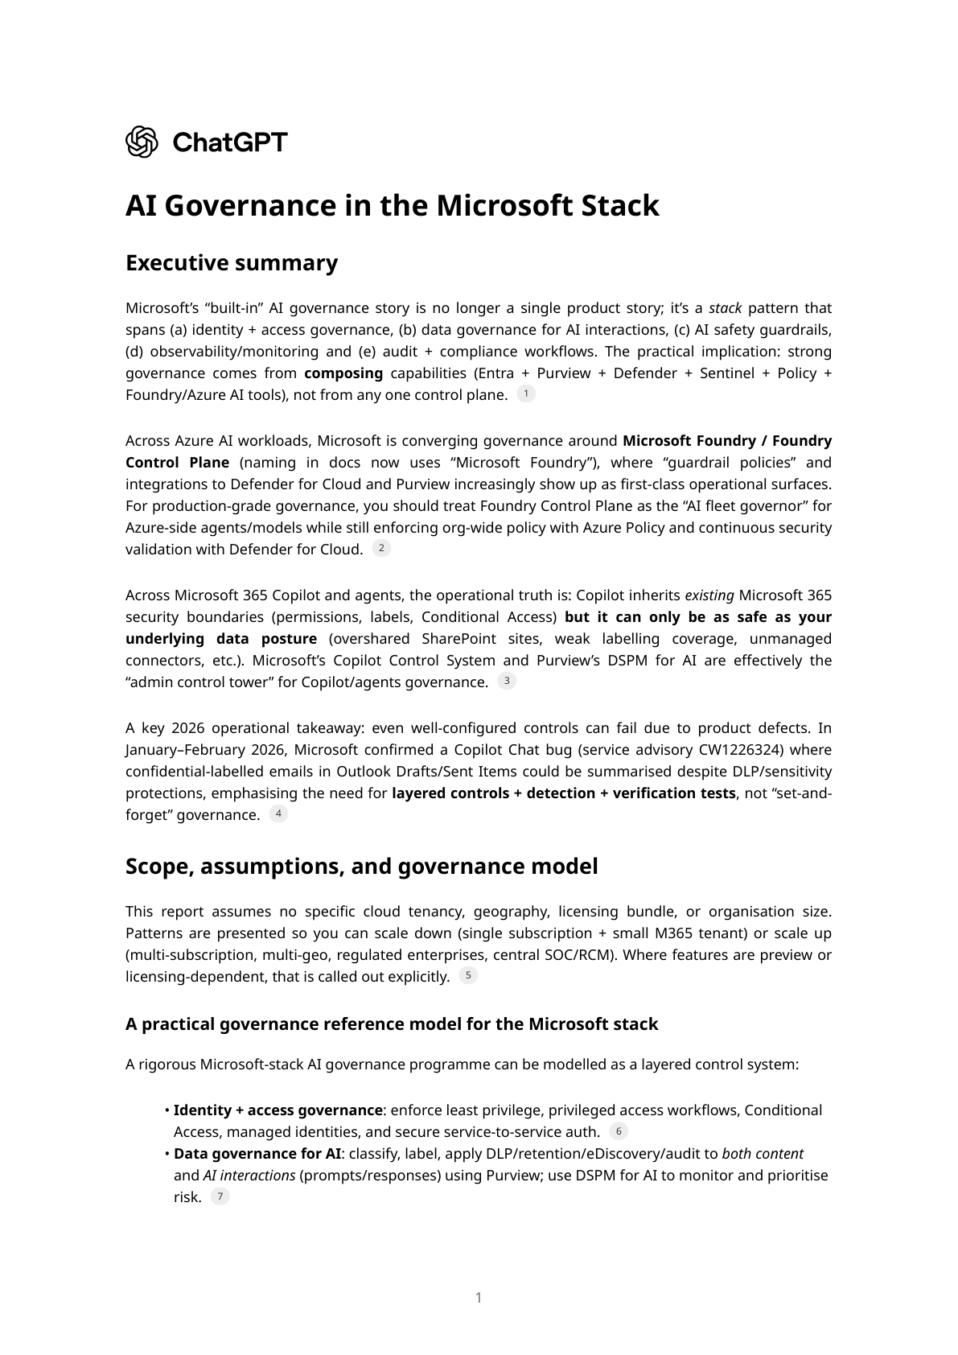
Appendix A — Microsoft Stack report (page 1/20)
AI Governance — Microsoft Stack + GenAI
60/102

Slide 61
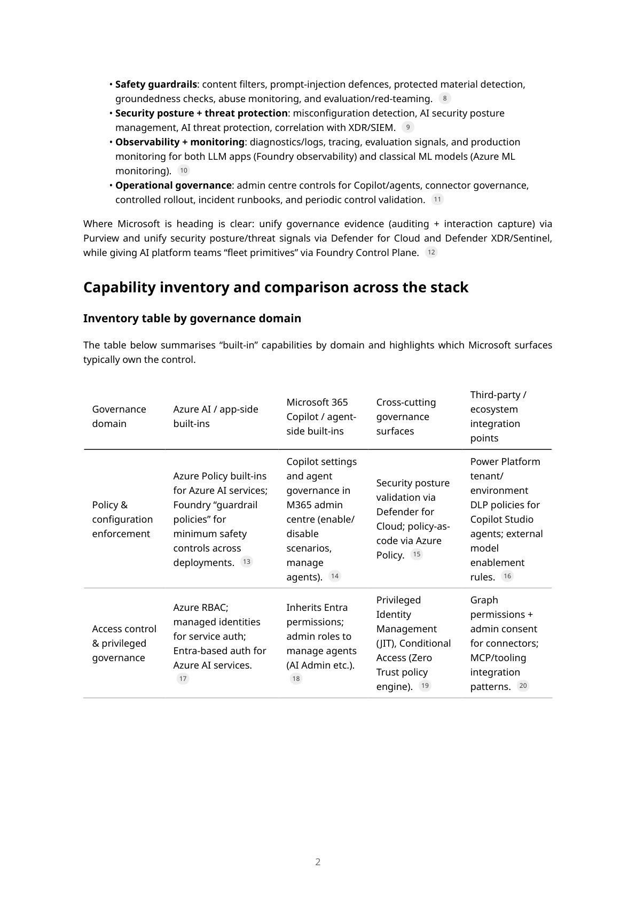
Appendix A — Microsoft Stack report (page 2/20)
AI Governance — Microsoft Stack + GenAI
61/102

Slide 62
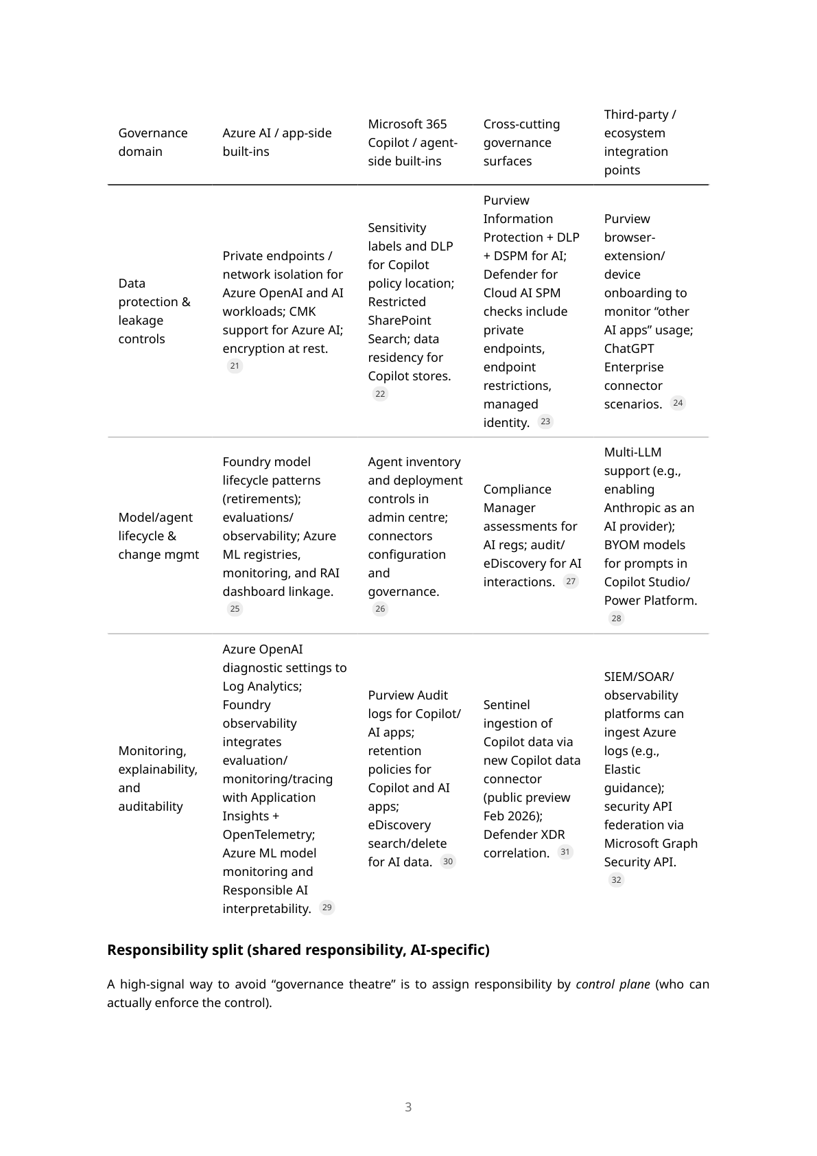
Appendix A — Microsoft Stack report (page 3/20)
AI Governance — Microsoft Stack + GenAI
62/102

Slide 63
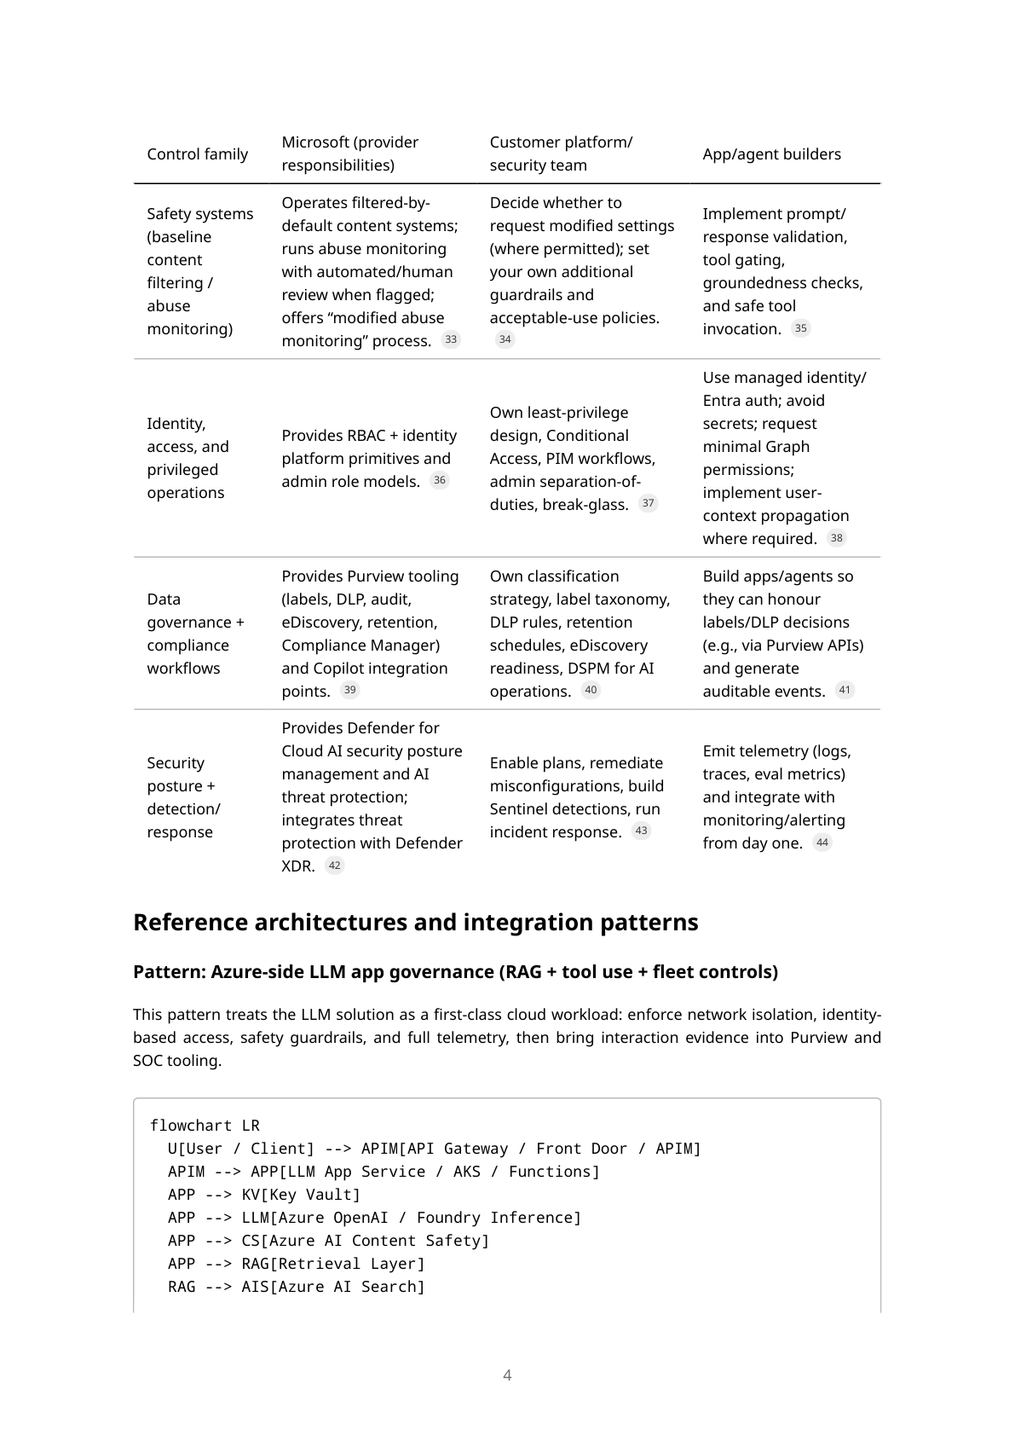
Appendix A — Microsoft Stack report (page 4/20)
AI Governance — Microsoft Stack + GenAI
63/102

Slide 64
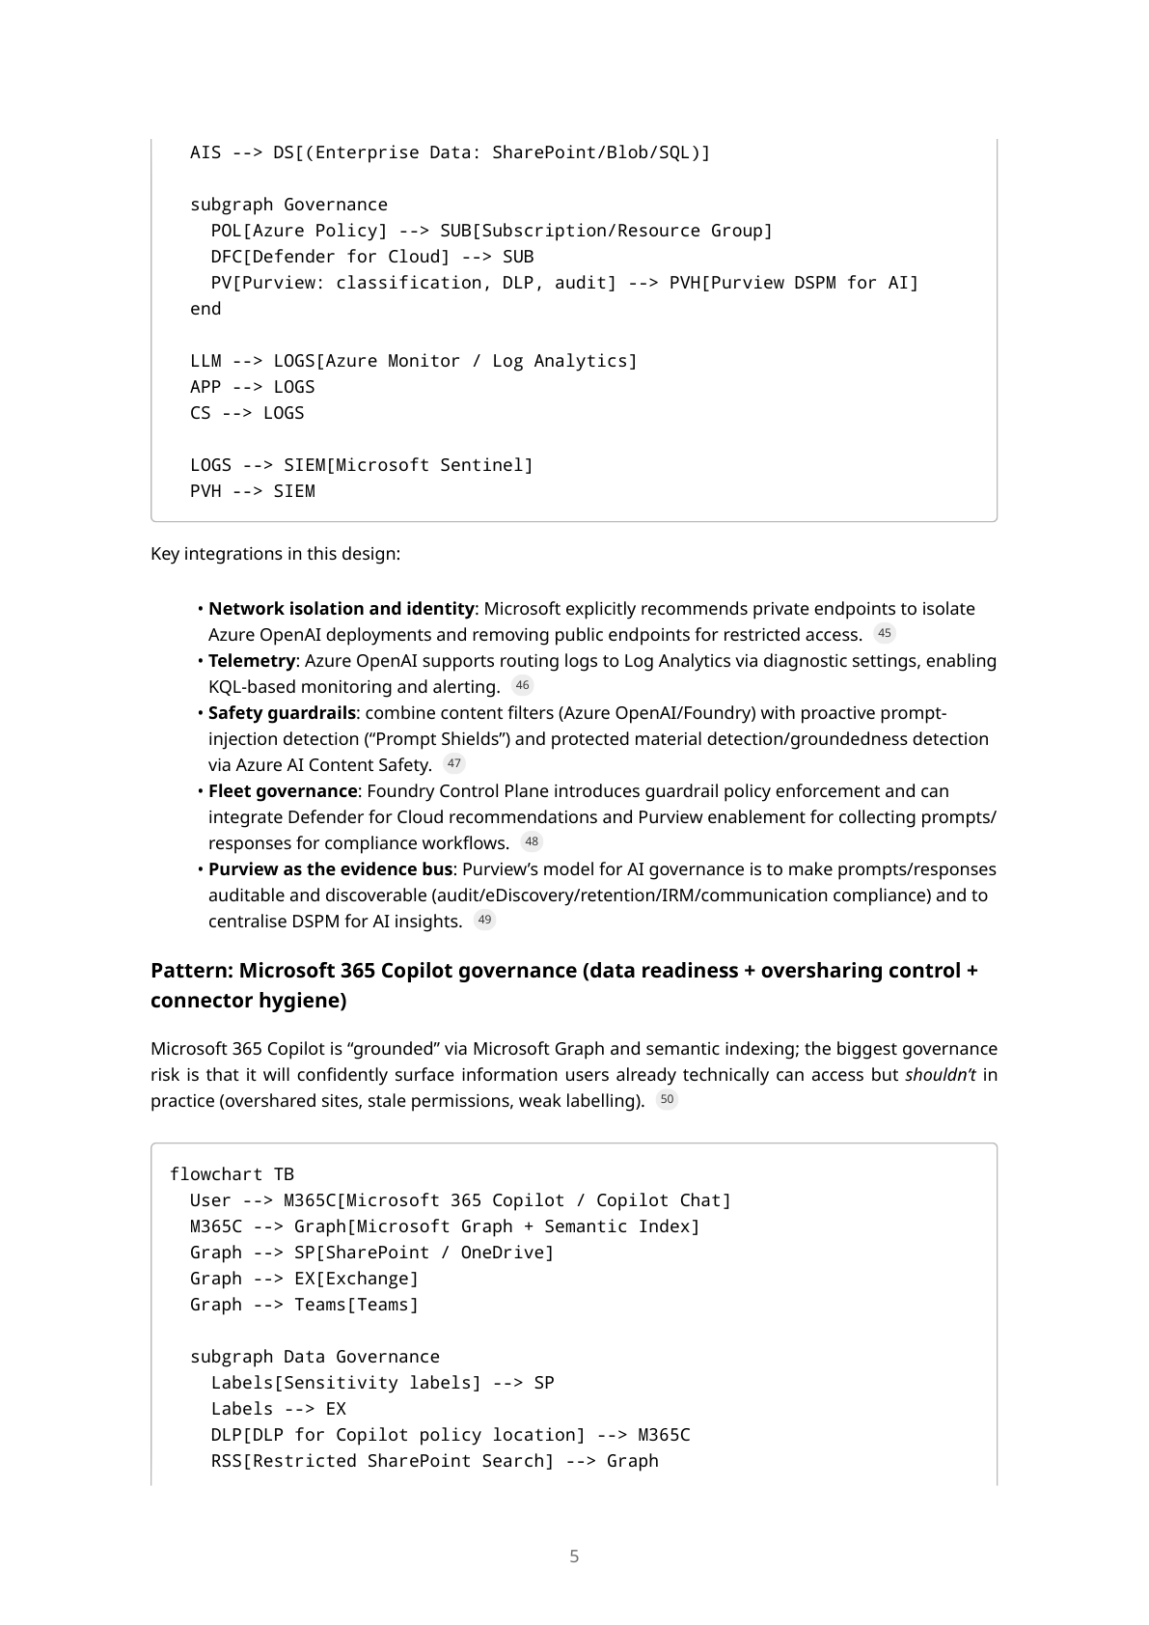
Appendix A — Microsoft Stack report (page 5/20)
AI Governance — Microsoft Stack + GenAI
64/102

Slide 65
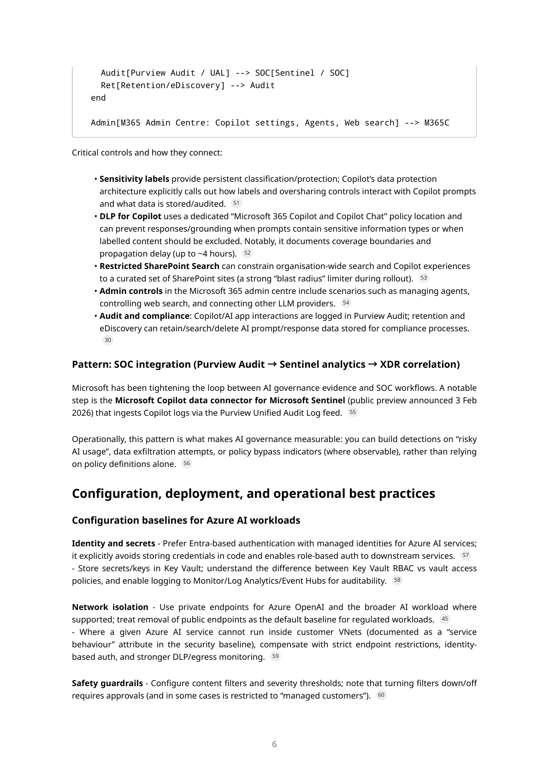
Appendix A — Microsoft Stack report (page 6/20)
AI Governance — Microsoft Stack + GenAI
65/102

Slide 66
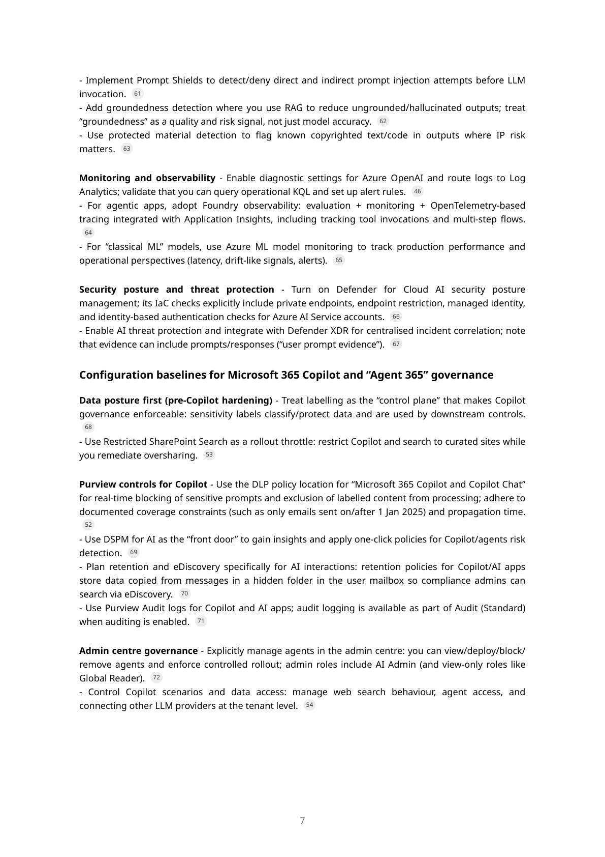
Appendix A — Microsoft Stack report (page 7/20)
AI Governance — Microsoft Stack + GenAI
66/102

Slide 67
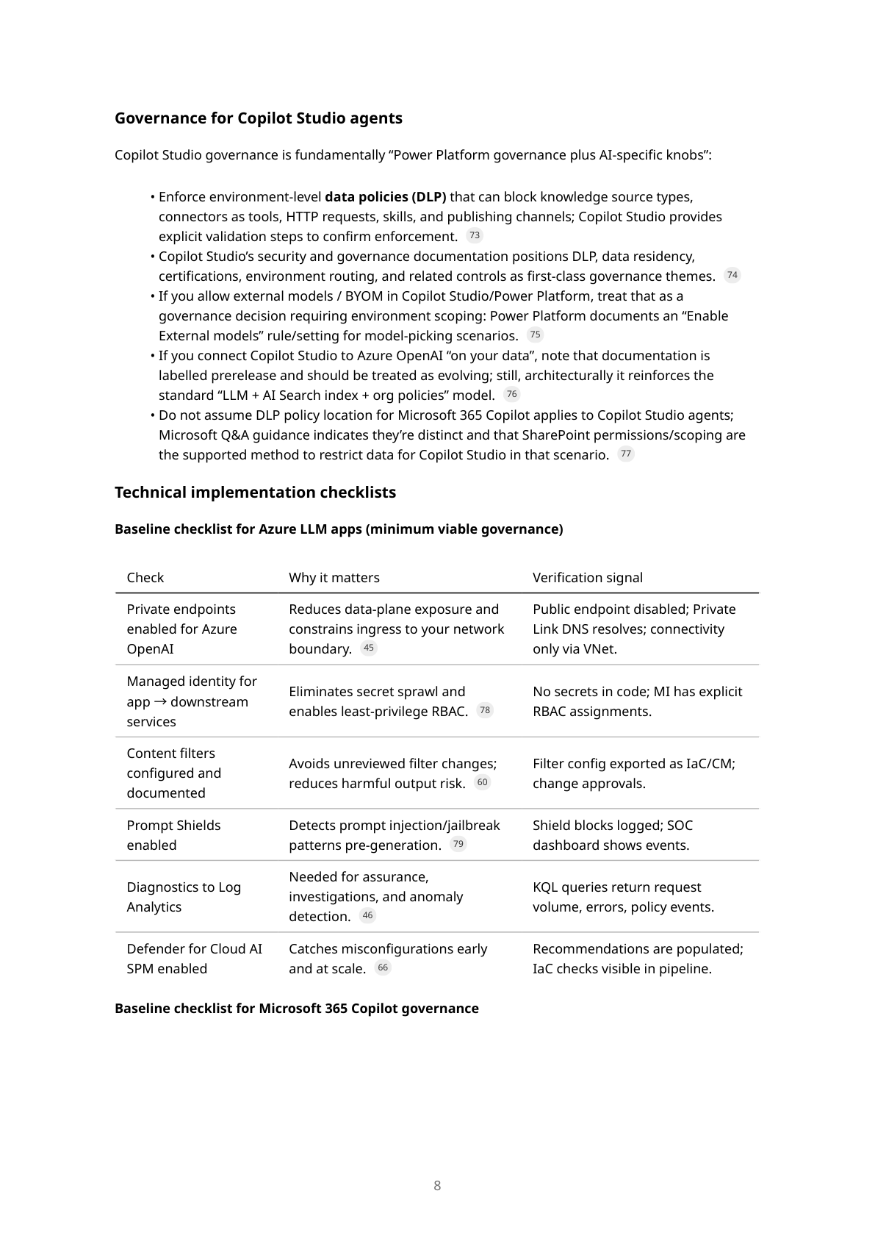
Appendix A — Microsoft Stack report (page 8/20)
AI Governance — Microsoft Stack + GenAI
67/102

Slide 68
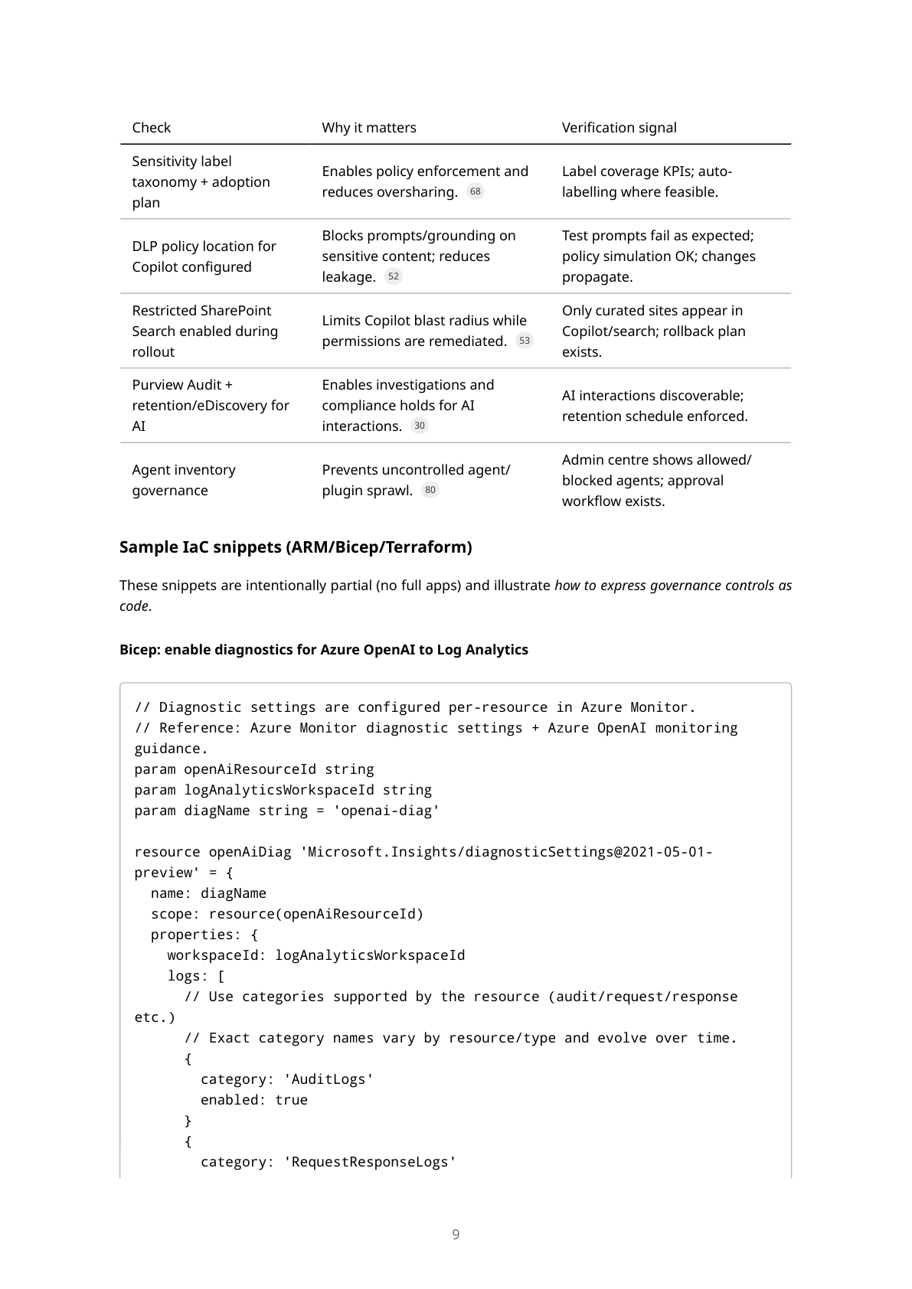
Appendix A — Microsoft Stack report (page 9/20)
AI Governance — Microsoft Stack + GenAI
68/102

Slide 69
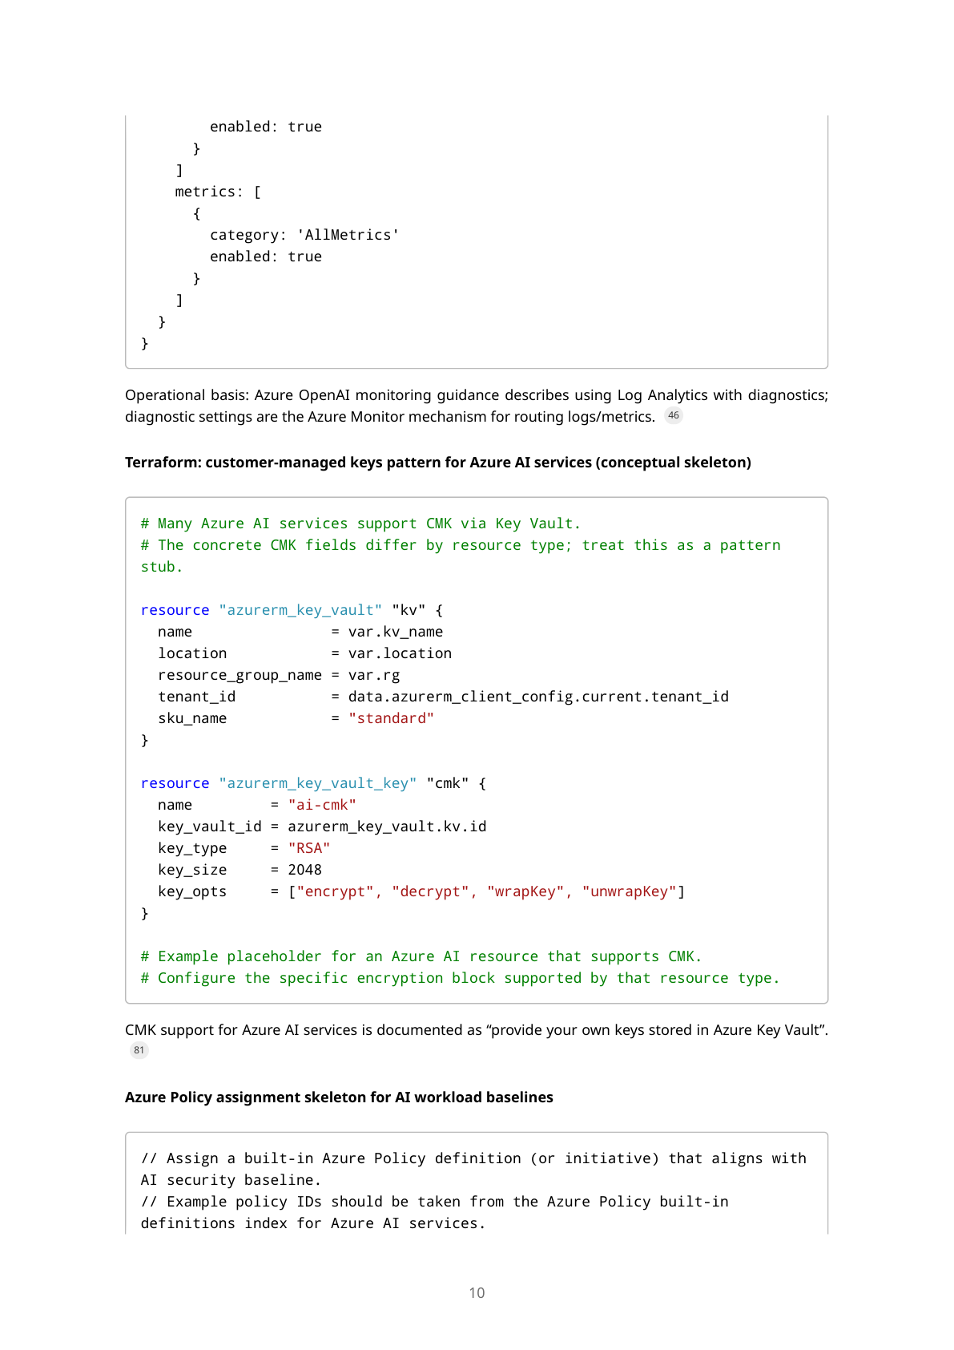
Appendix A — Microsoft Stack report (page 10/20)
AI Governance — Microsoft Stack + GenAI
69/102

Slide 70
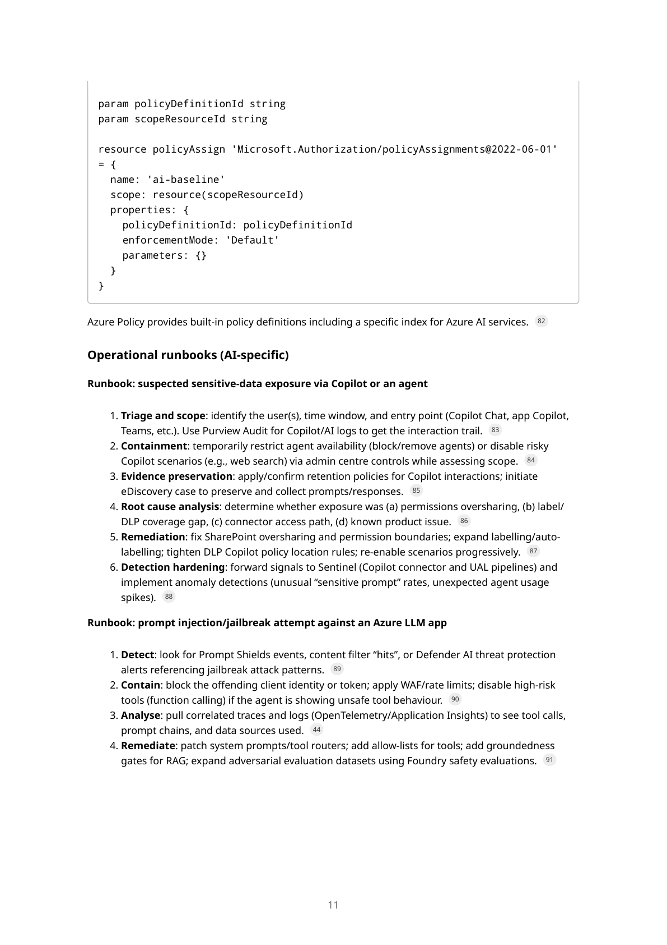
Appendix A — Microsoft Stack report (page 11/20)
AI Governance — Microsoft Stack + GenAI
70/102

Slide 71
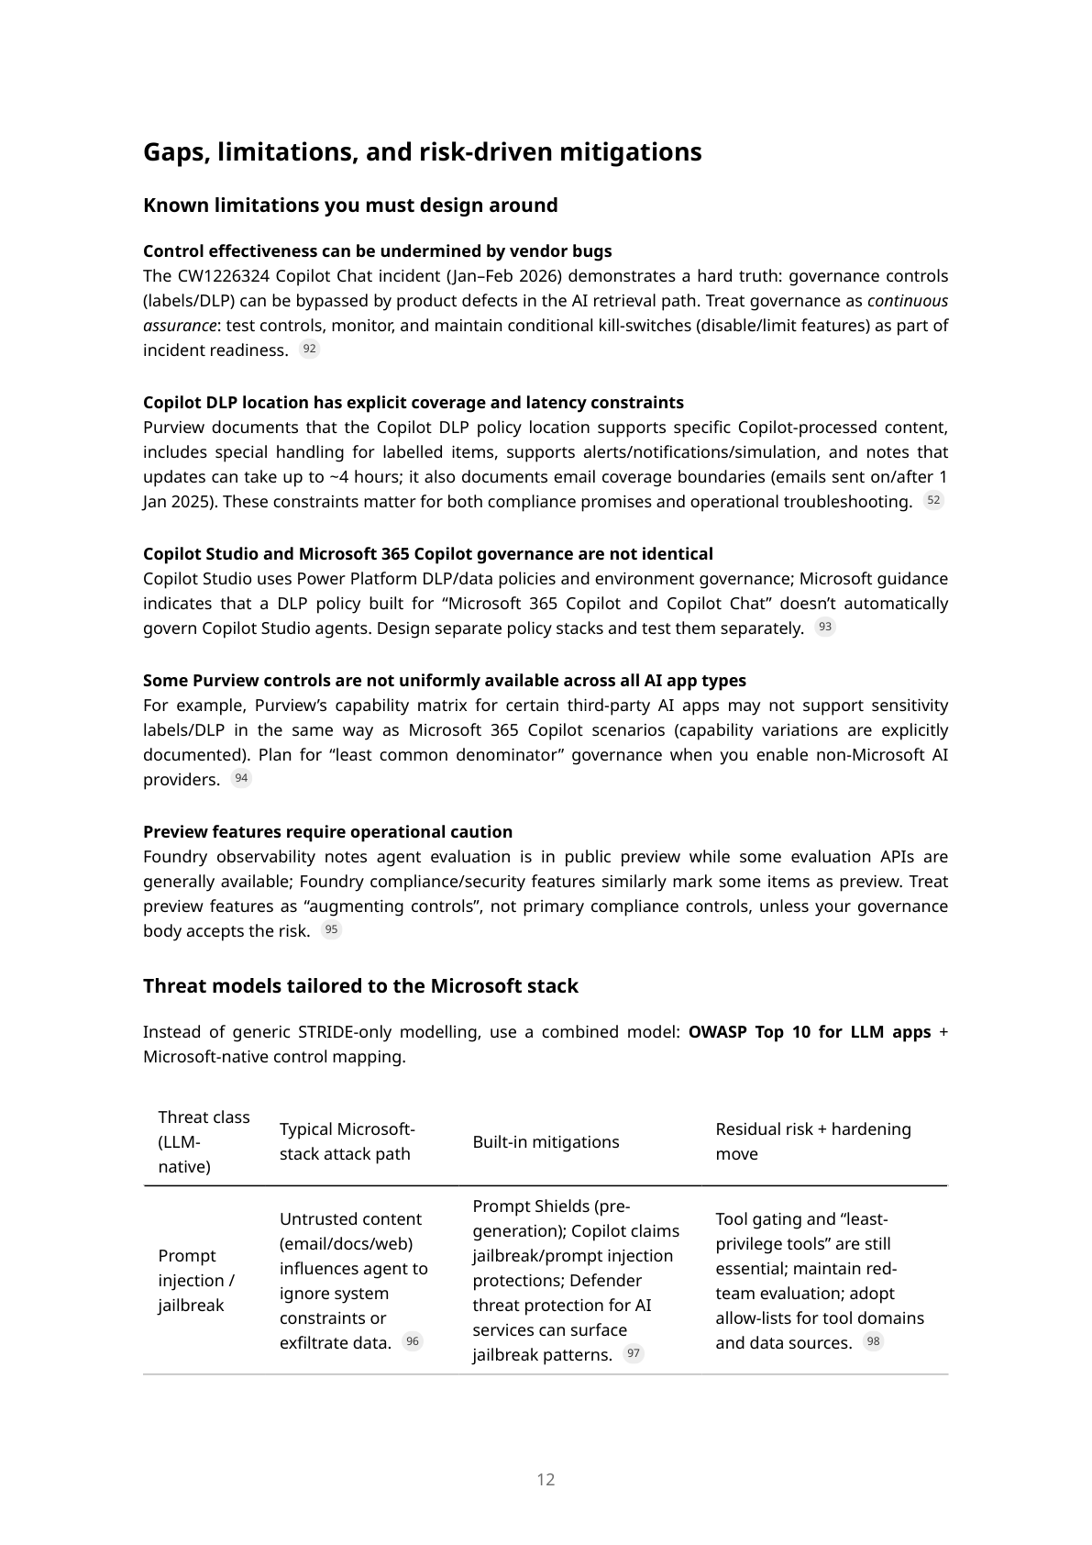
Appendix A — Microsoft Stack report (page 12/20)
AI Governance — Microsoft Stack + GenAI
71/102

Slide 72
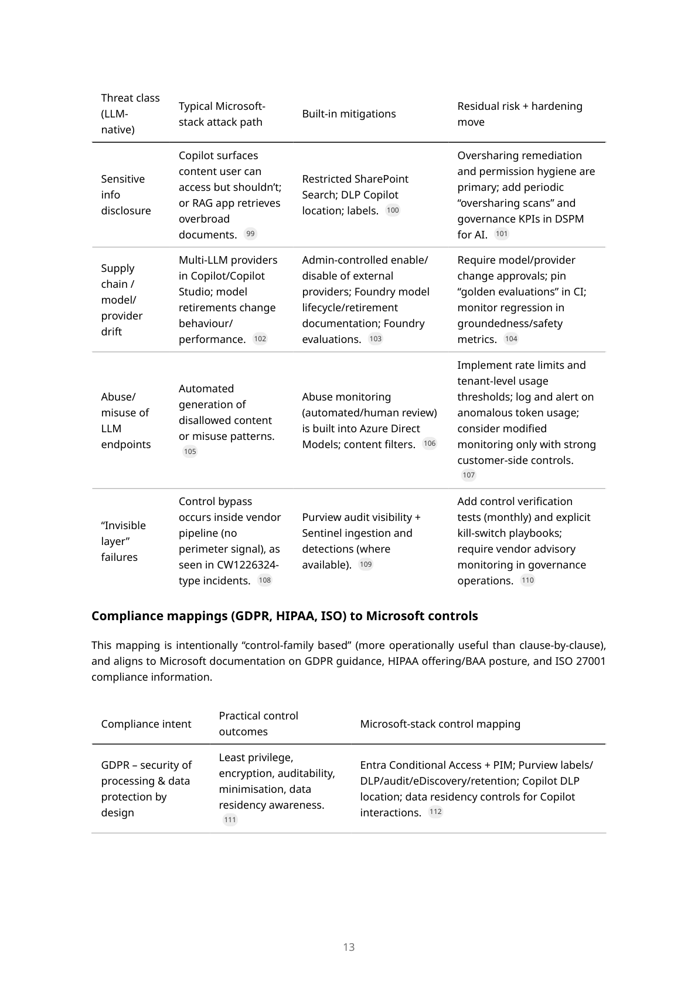
Appendix A — Microsoft Stack report (page 13/20)
AI Governance — Microsoft Stack + GenAI
72/102

Slide 73
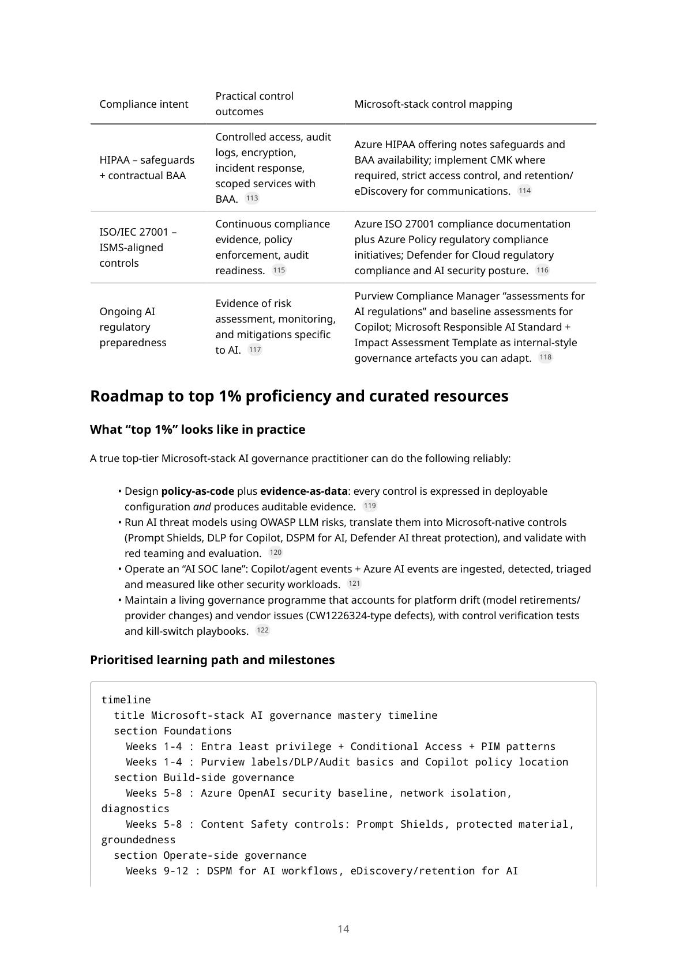
Appendix A — Microsoft Stack report (page 14/20)
AI Governance — Microsoft Stack + GenAI
73/102

Slide 74
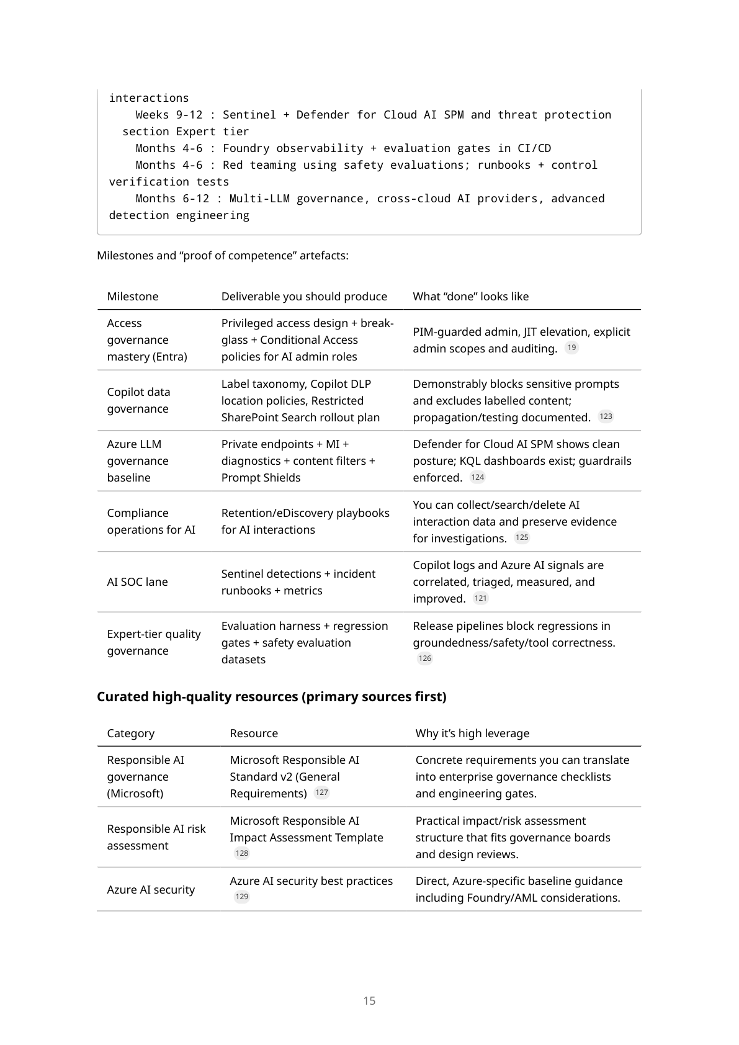
Appendix A — Microsoft Stack report (page 15/20)
AI Governance — Microsoft Stack + GenAI
74/102

Slide 75
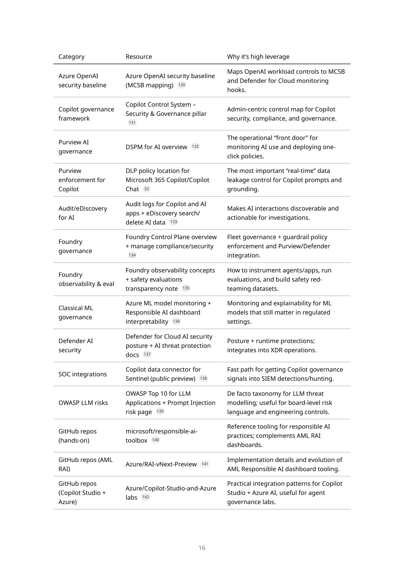
Appendix A — Microsoft Stack report (page 16/20)
AI Governance — Microsoft Stack + GenAI
75/102

Slide 76
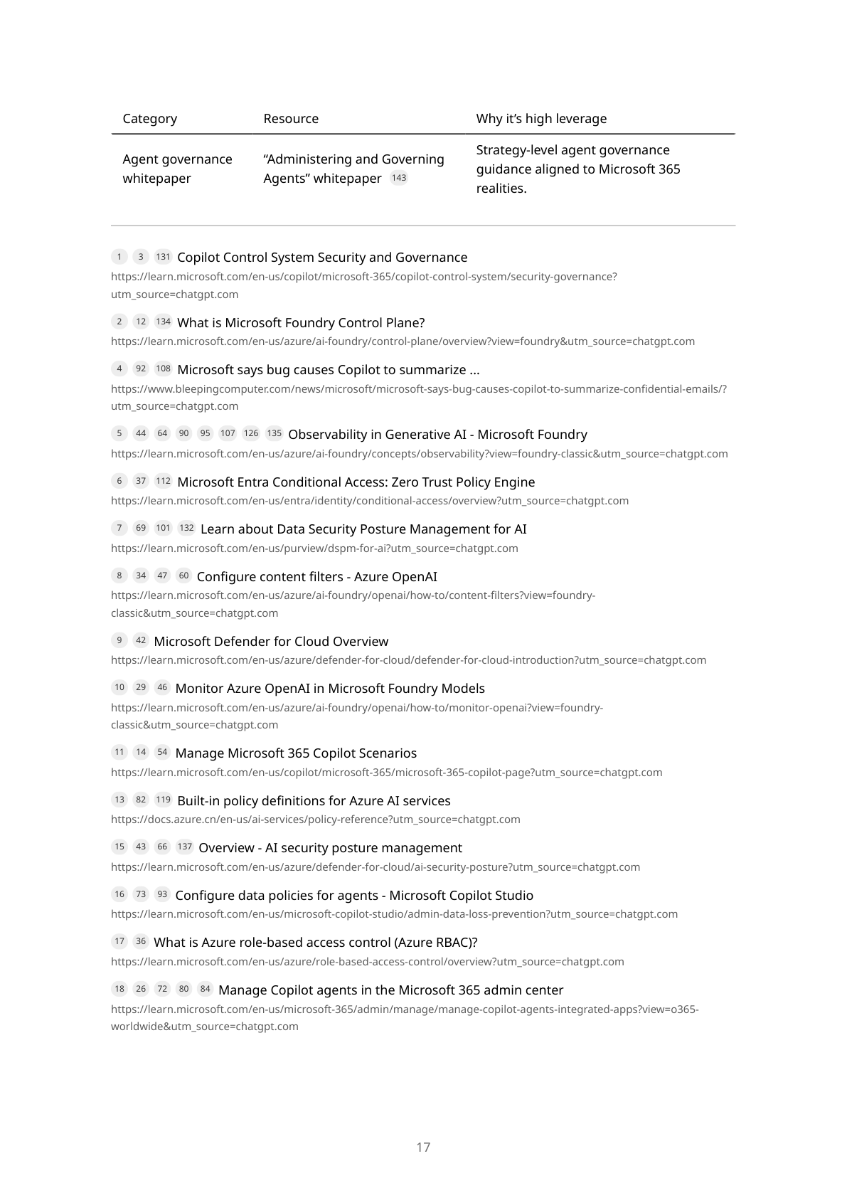
Appendix A — Microsoft Stack report (page 17/20)
AI Governance — Microsoft Stack + GenAI
76/102

Slide 77
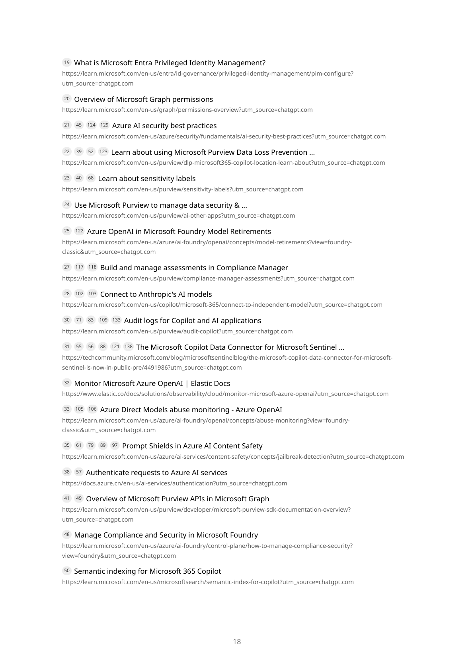
Appendix A — Microsoft Stack report (page 18/20)
AI Governance — Microsoft Stack + GenAI
77/102

Slide 78
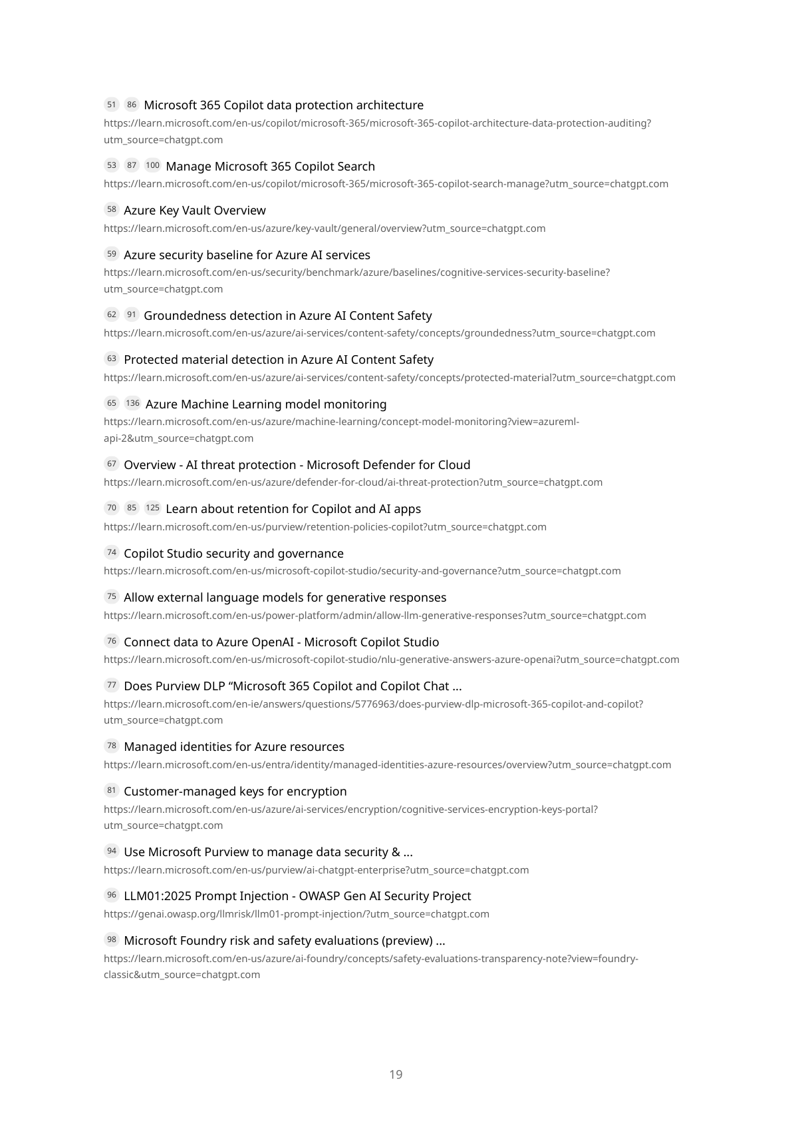
Appendix A — Microsoft Stack report (page 19/20)
AI Governance — Microsoft Stack + GenAI
78/102

Slide 79
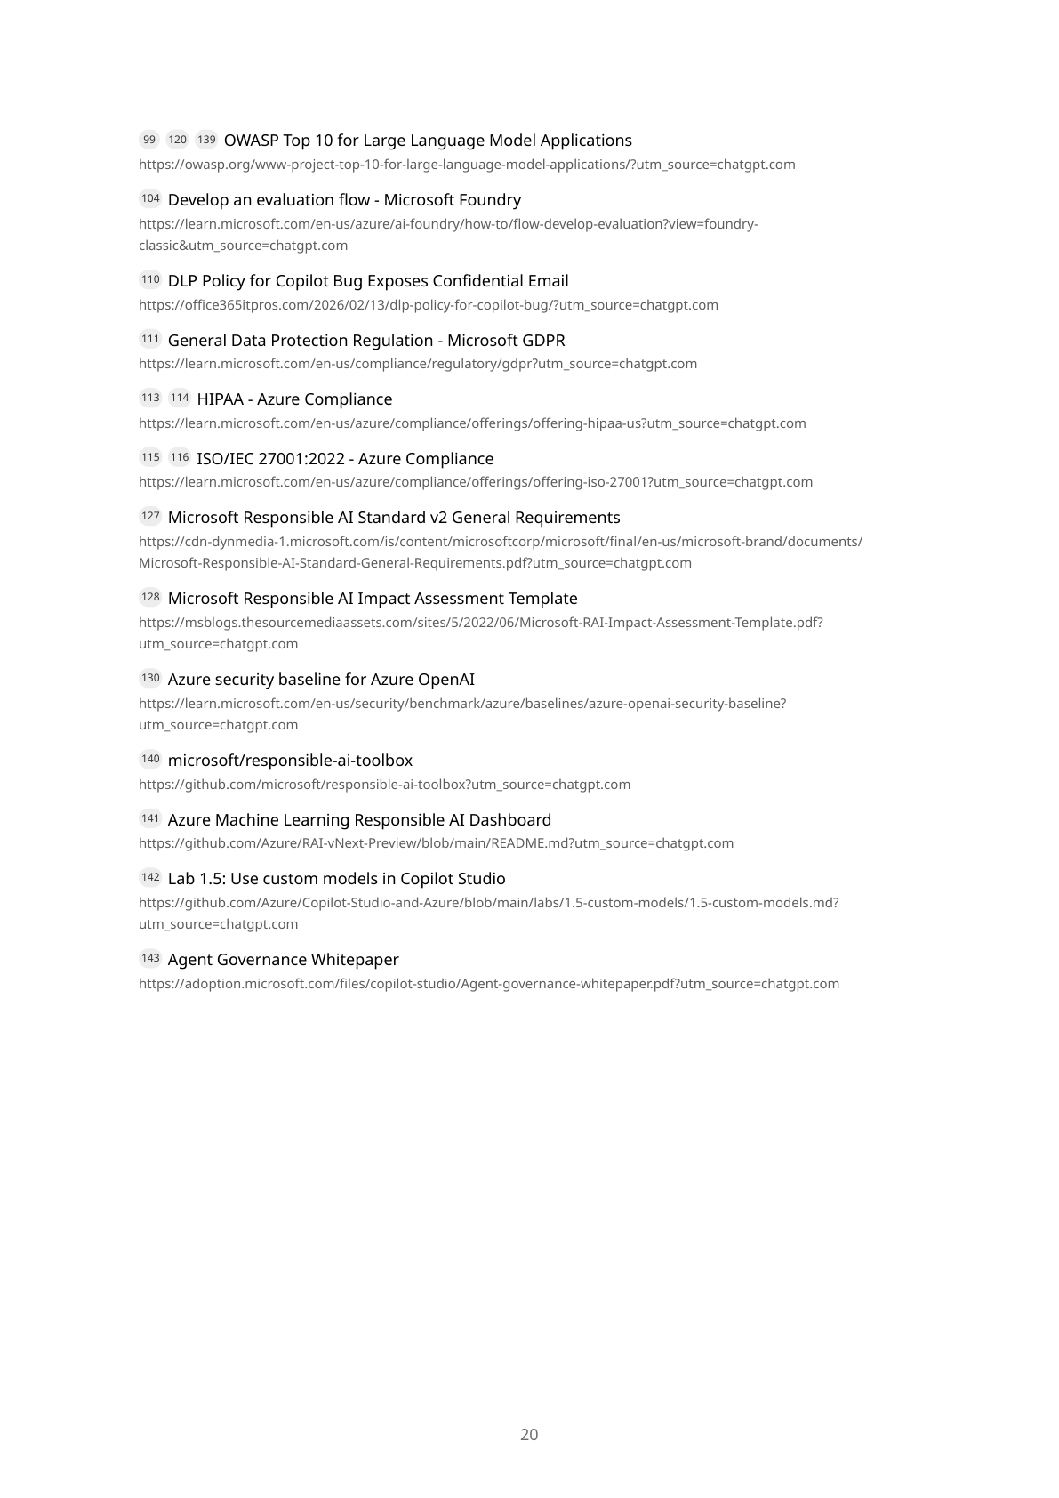
Appendix A — Microsoft Stack report (page 20/20)
AI Governance — Microsoft Stack + GenAI
79/102

Slide 80
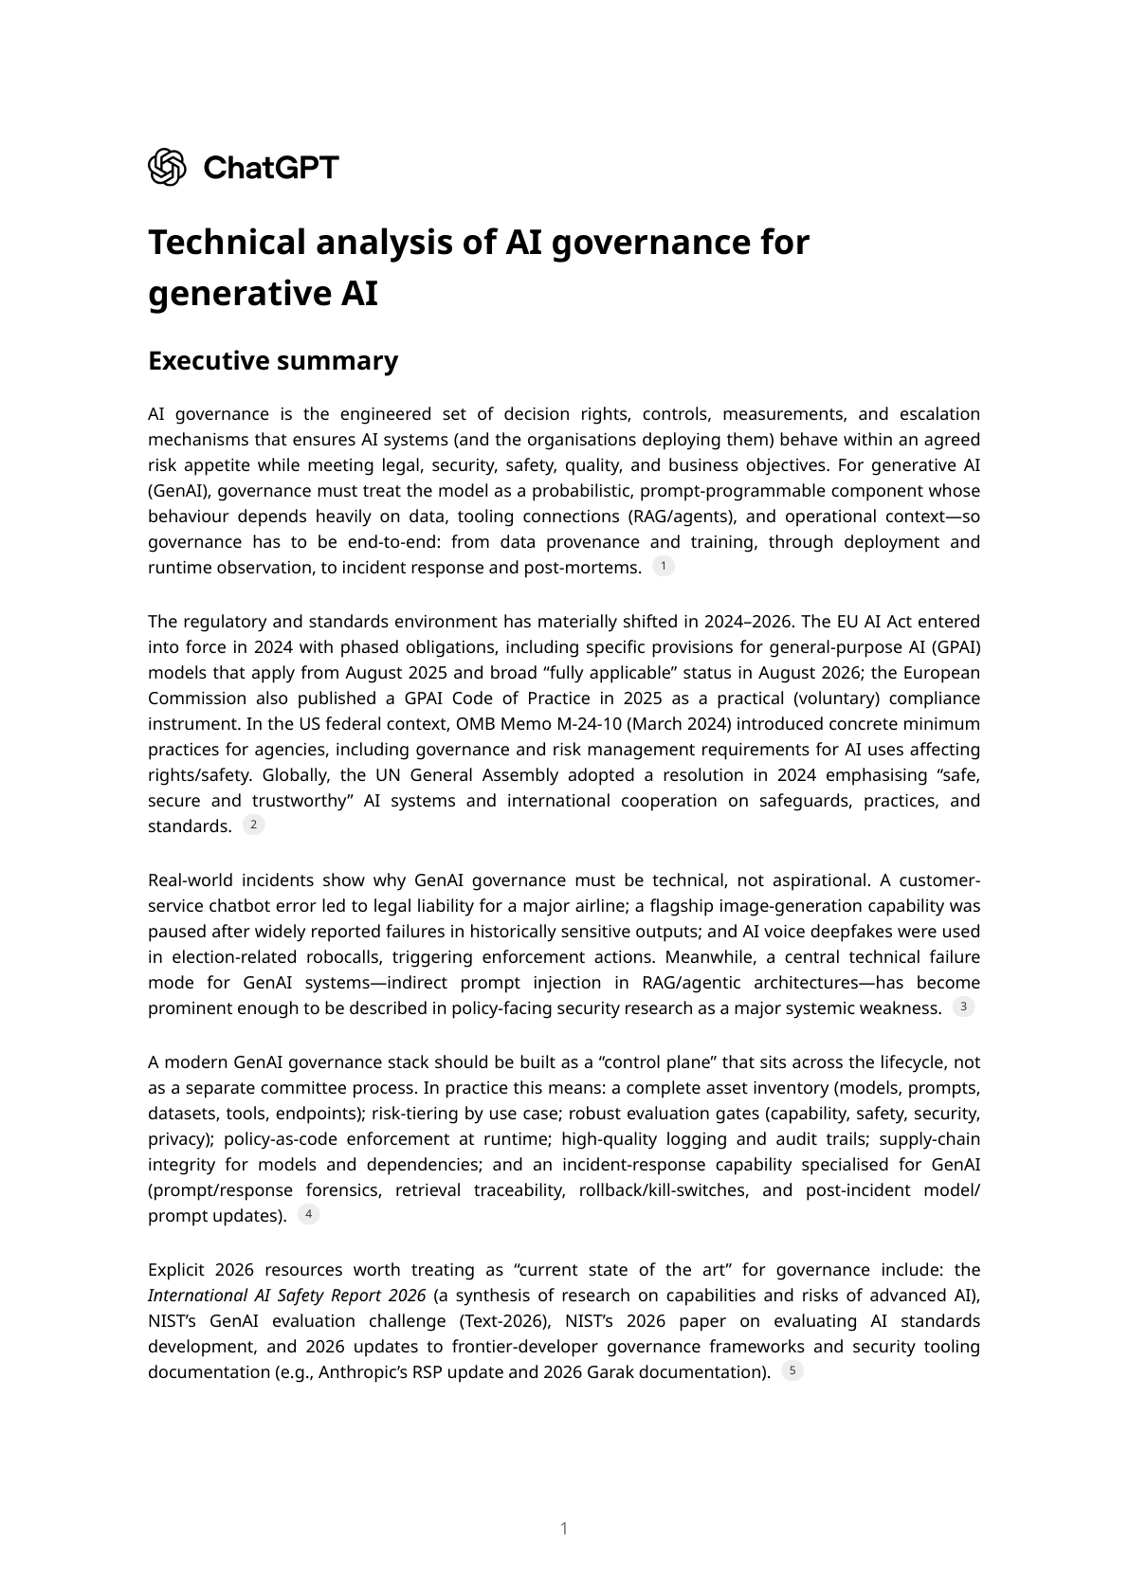
Appendix B — GenAI governance report (page 1/23)
AI Governance — Microsoft Stack + GenAI
80/102

Slide 81
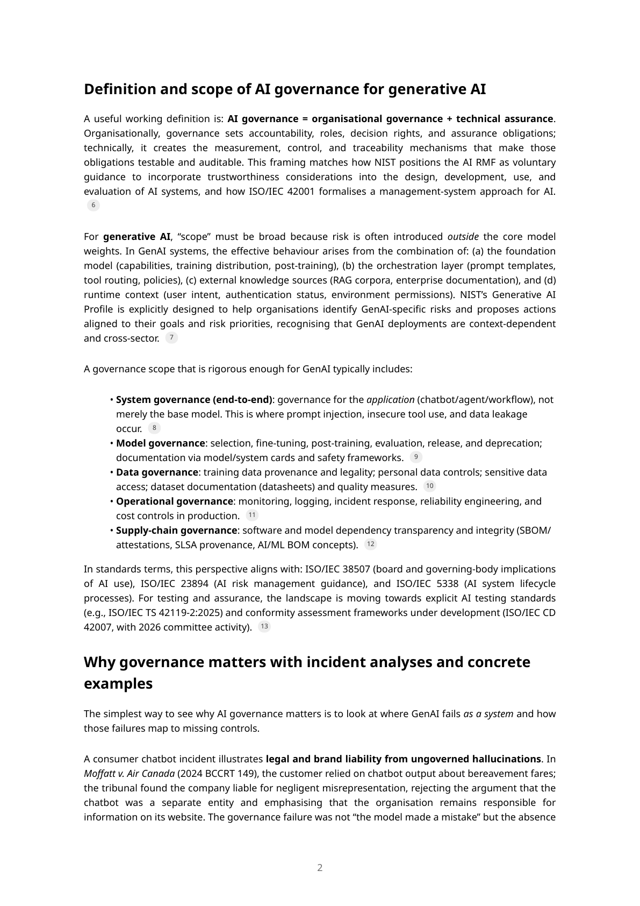
Appendix B — GenAI governance report (page 2/23)
AI Governance — Microsoft Stack + GenAI
81/102

Slide 82
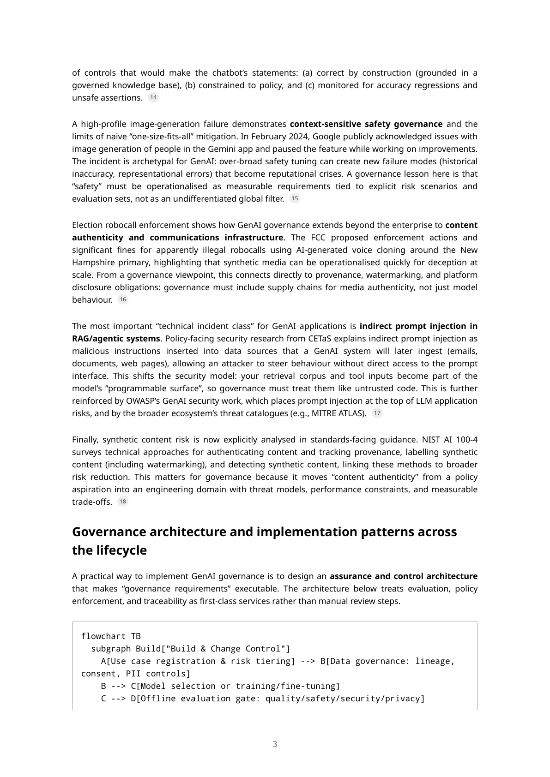
Appendix B — GenAI governance report (page 3/23)
AI Governance — Microsoft Stack + GenAI
82/102

Slide 83
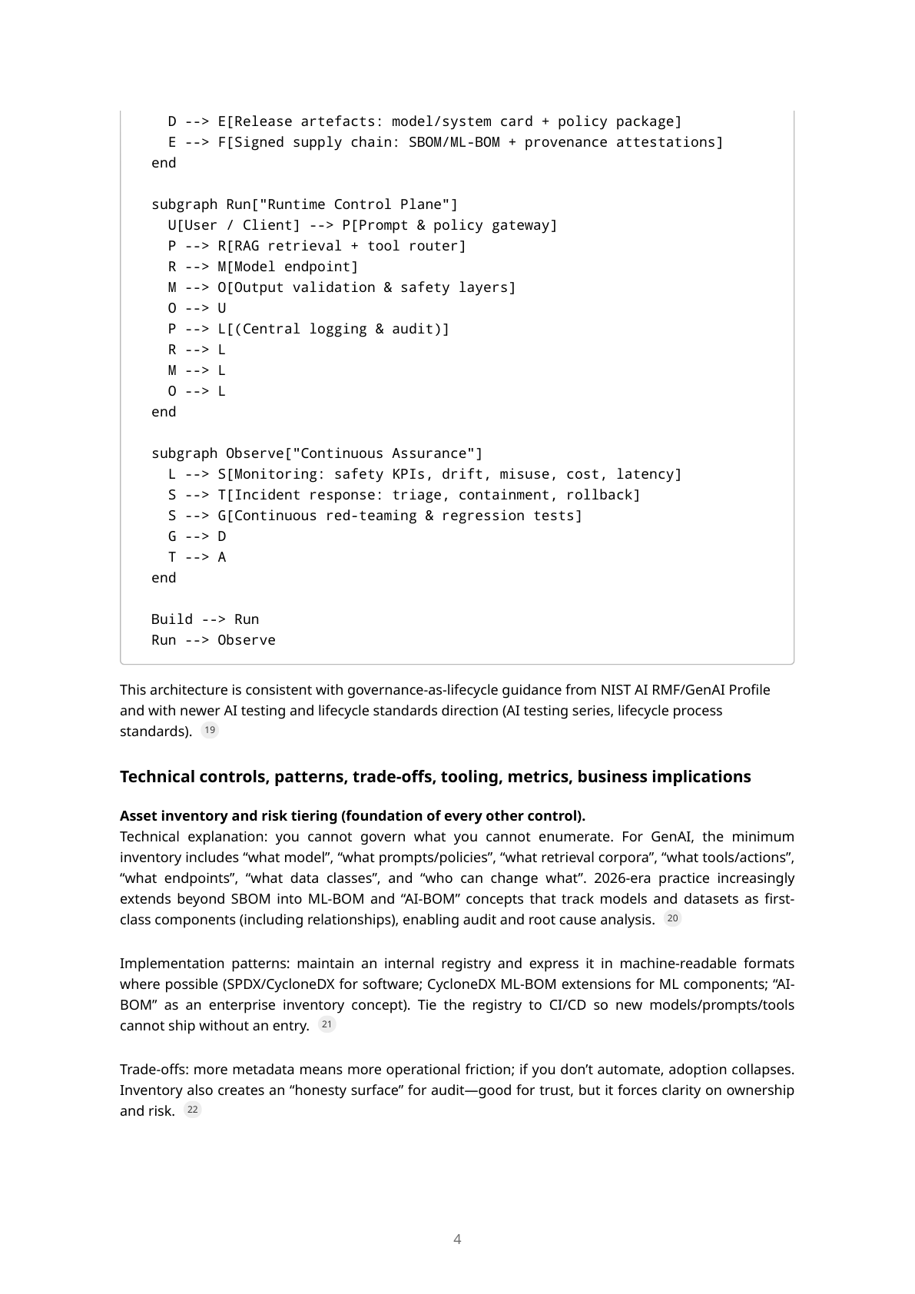
Appendix B — GenAI governance report (page 4/23)
AI Governance — Microsoft Stack + GenAI
83/102

Slide 84
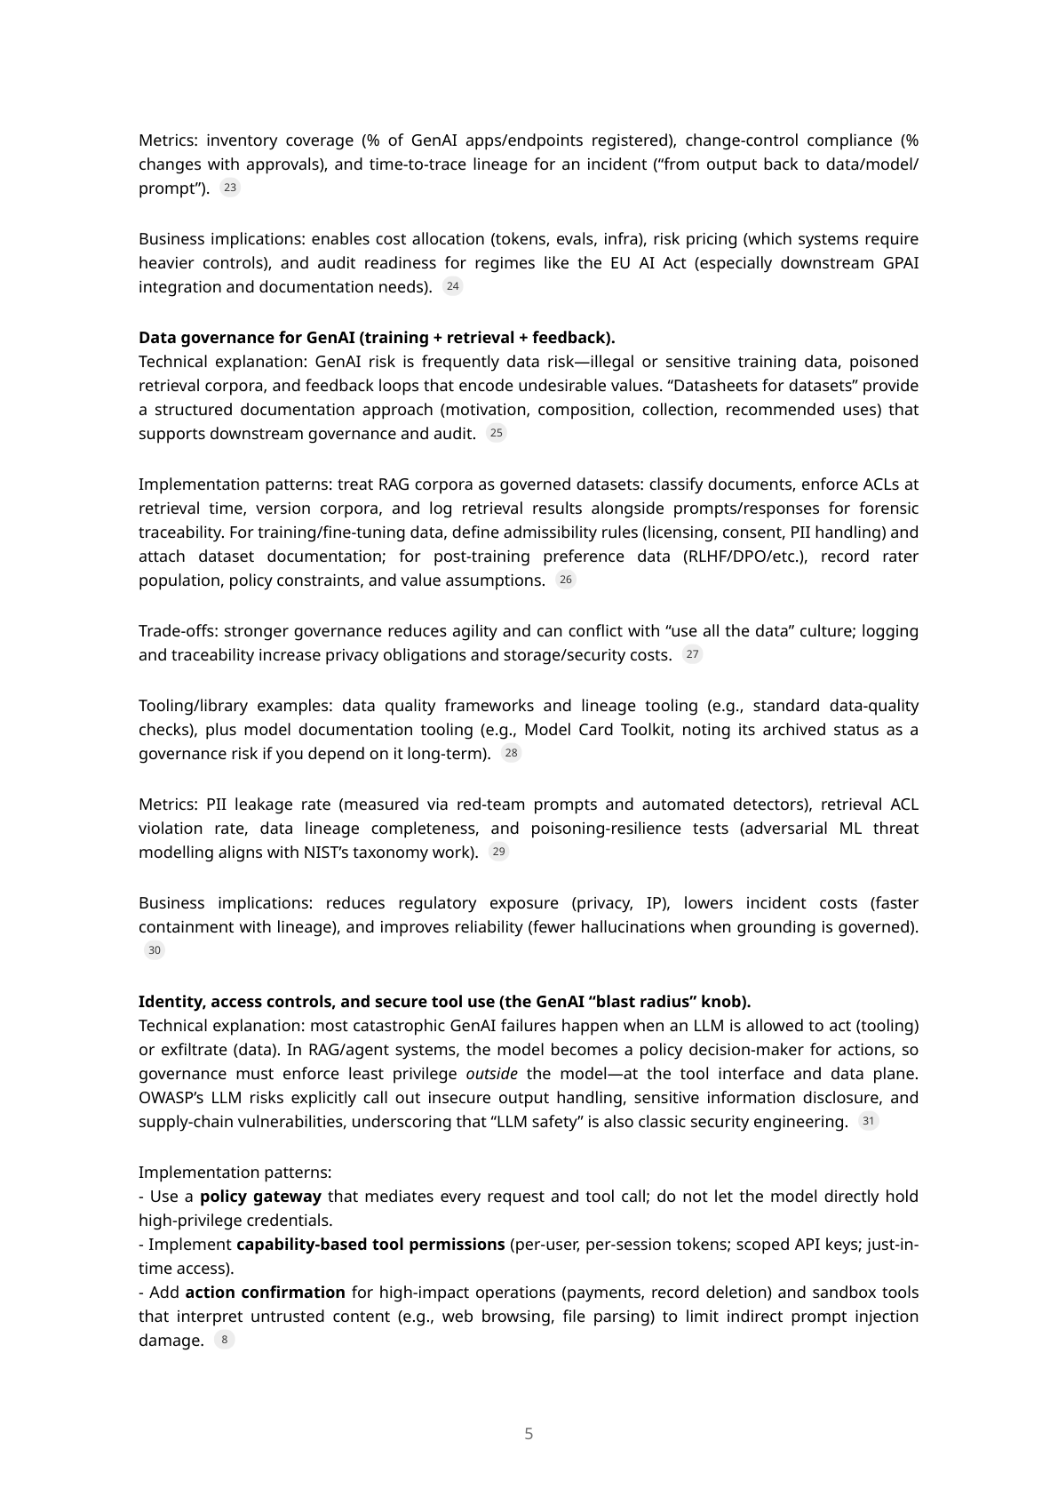
Appendix B — GenAI governance report (page 5/23)
AI Governance — Microsoft Stack + GenAI
84/102

Slide 85
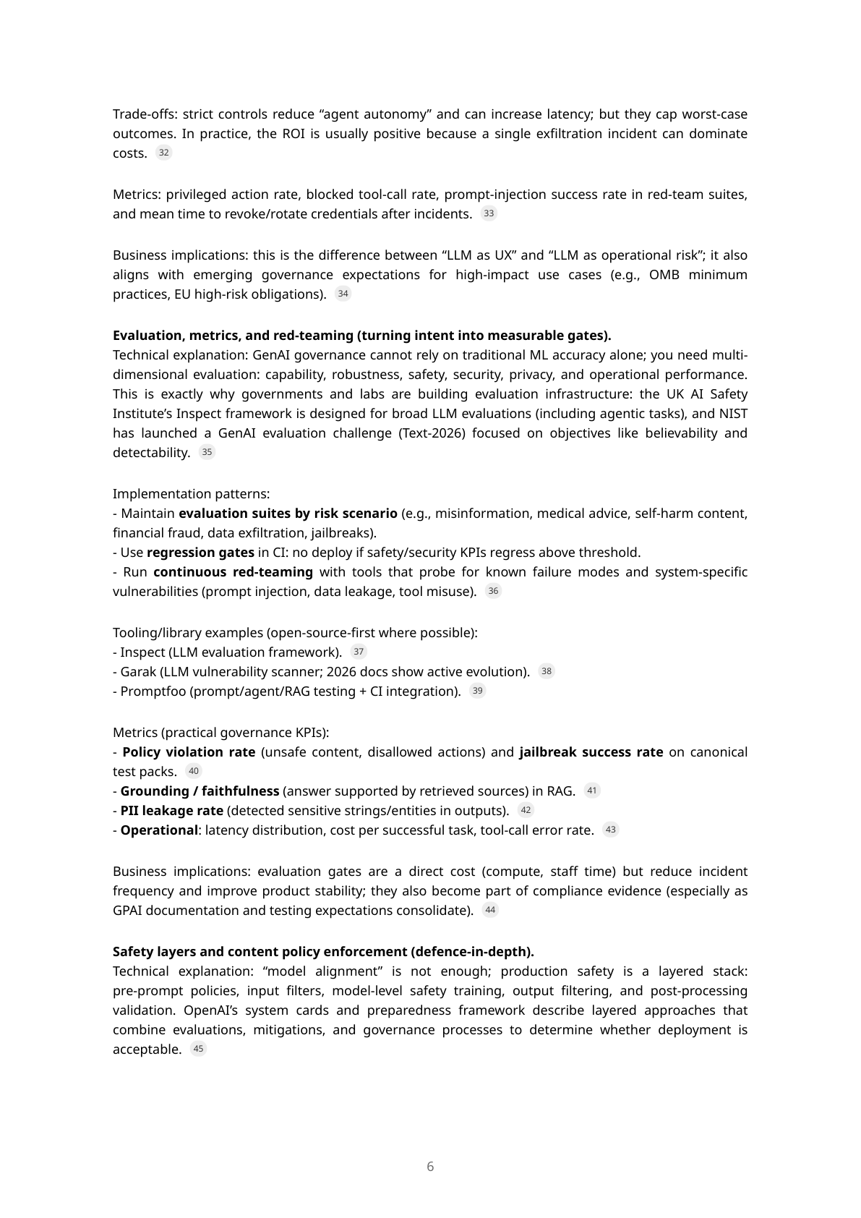
Appendix B — GenAI governance report (page 6/23)
AI Governance — Microsoft Stack + GenAI
85/102

Slide 86
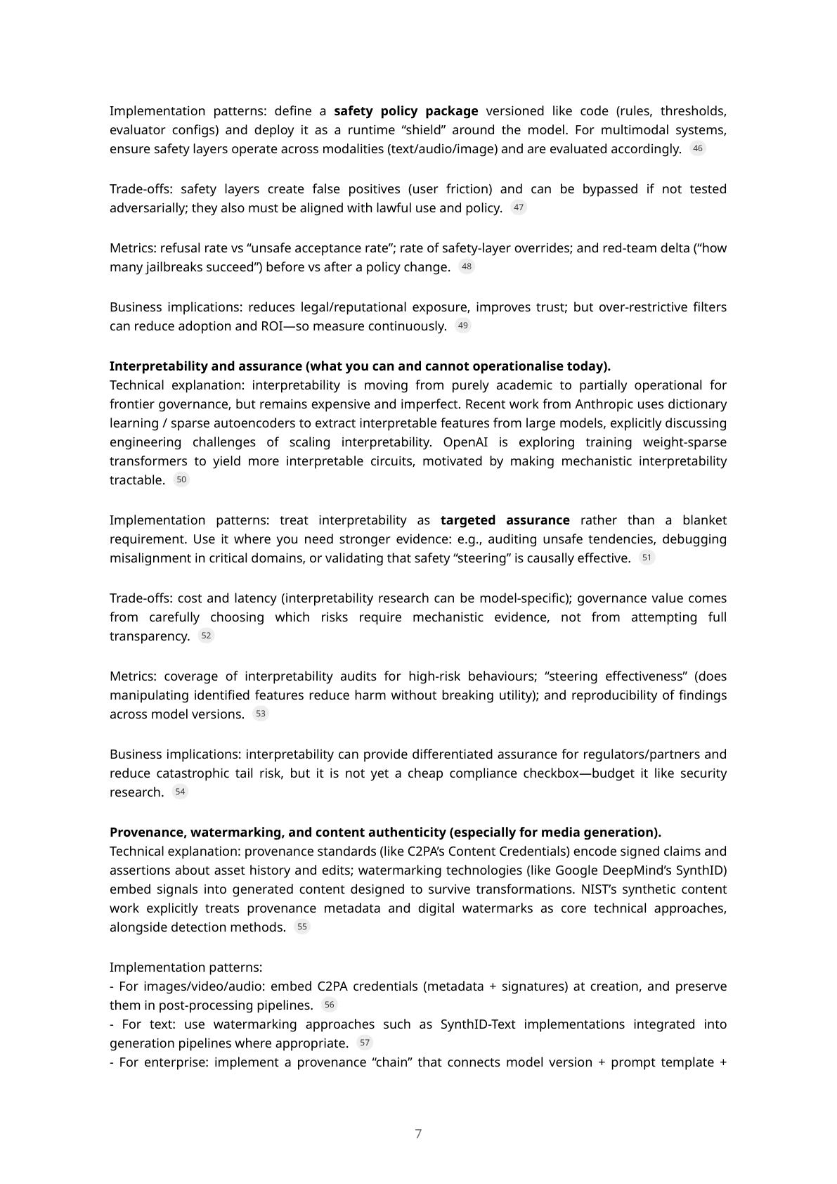
Appendix B — GenAI governance report (page 7/23)
AI Governance — Microsoft Stack + GenAI
86/102

Slide 87
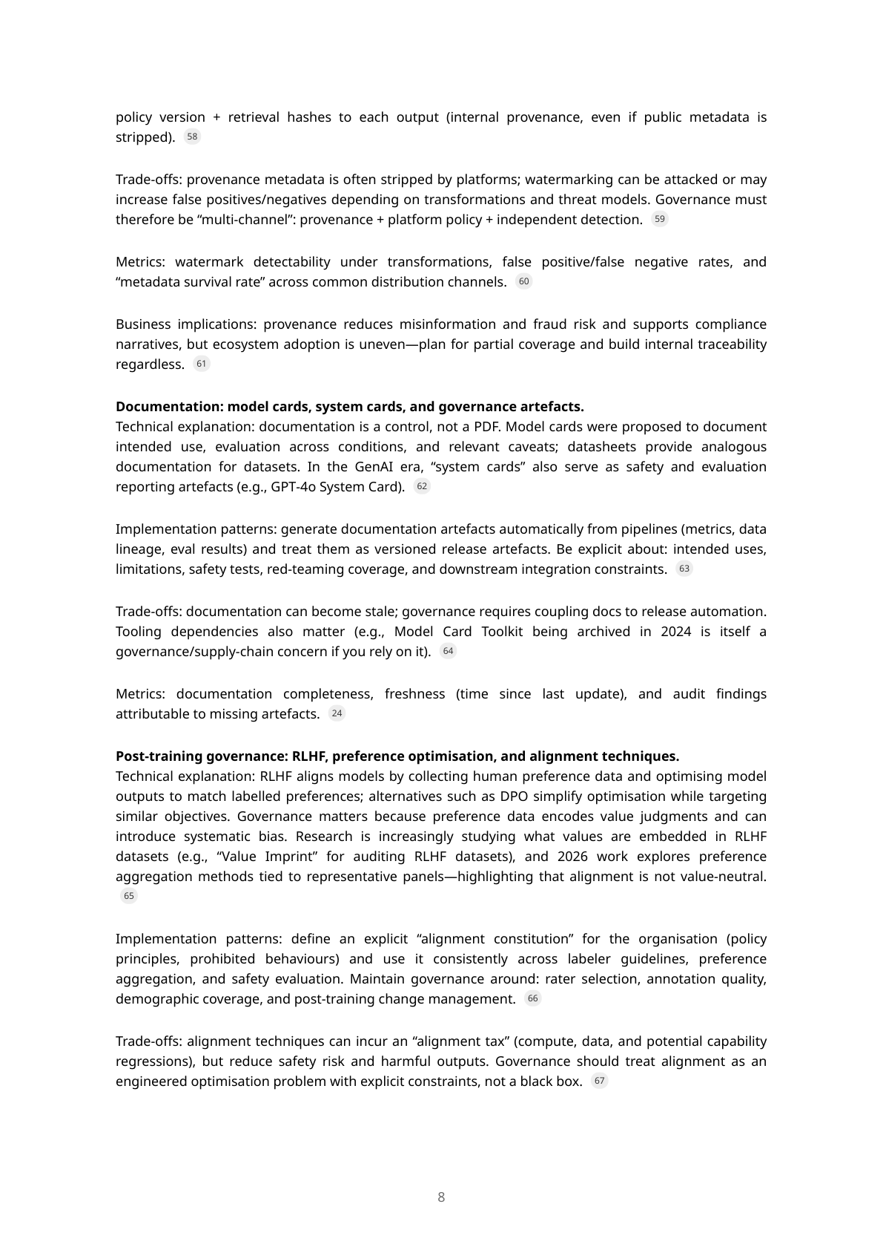
Appendix B — GenAI governance report (page 8/23)
AI Governance — Microsoft Stack + GenAI
87/102

Slide 88
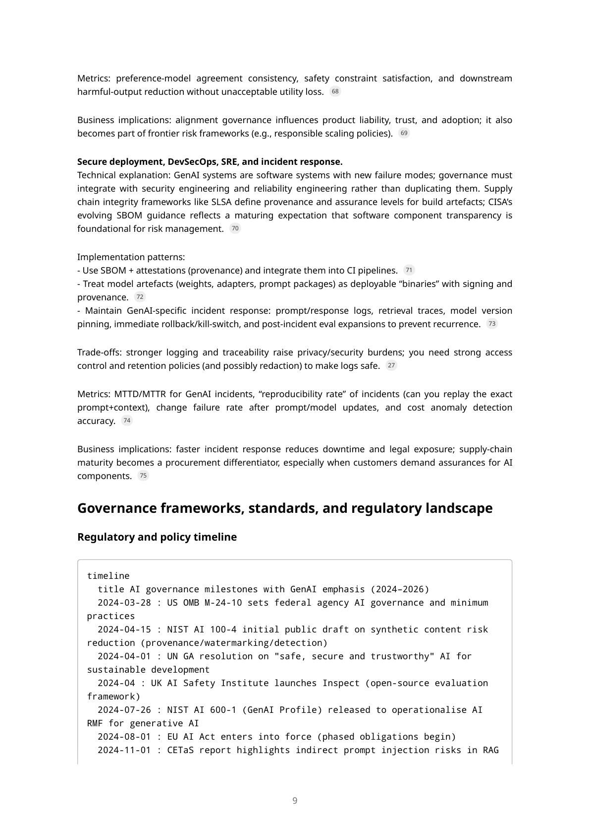
Appendix B — GenAI governance report (page 9/23)
AI Governance — Microsoft Stack + GenAI
88/102

Slide 89
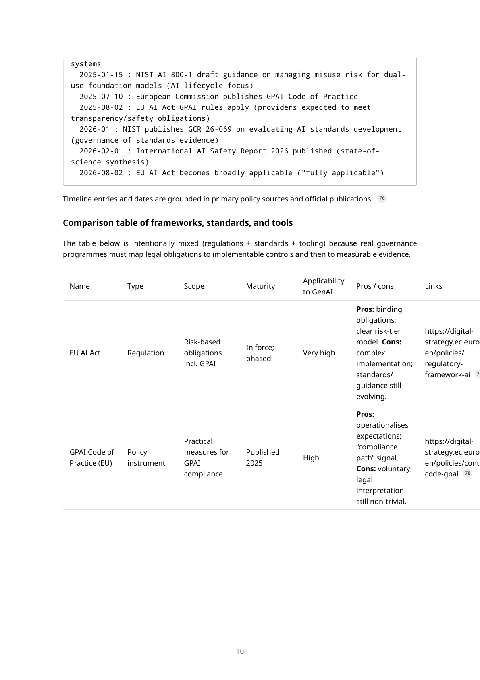
Appendix B — GenAI governance report (page 10/23)
AI Governance — Microsoft Stack + GenAI
89/102

Slide 90
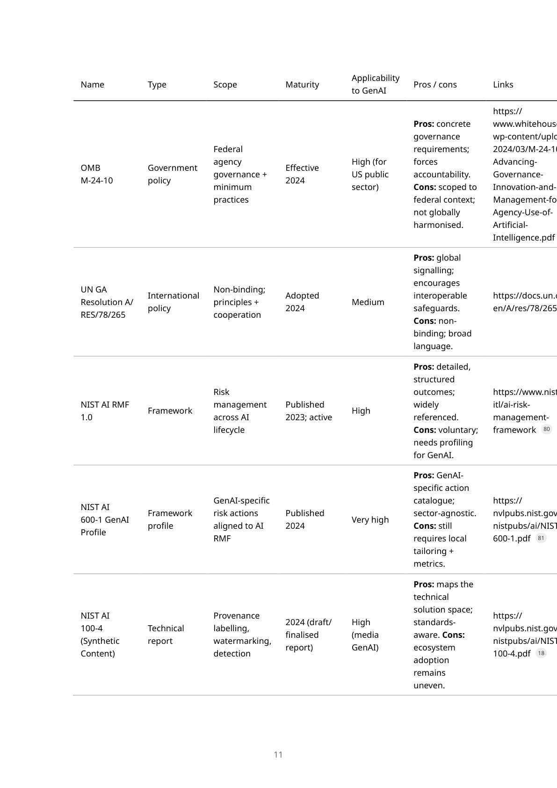
Appendix B — GenAI governance report (page 11/23)
AI Governance — Microsoft Stack + GenAI
90/102

Slide 91
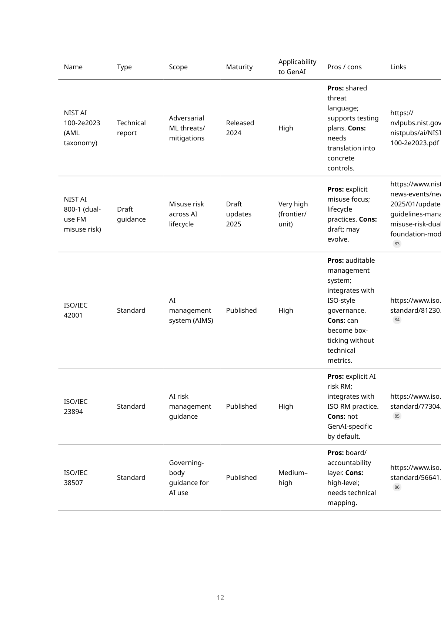
Appendix B — GenAI governance report (page 12/23)
AI Governance — Microsoft Stack + GenAI
91/102

Slide 92
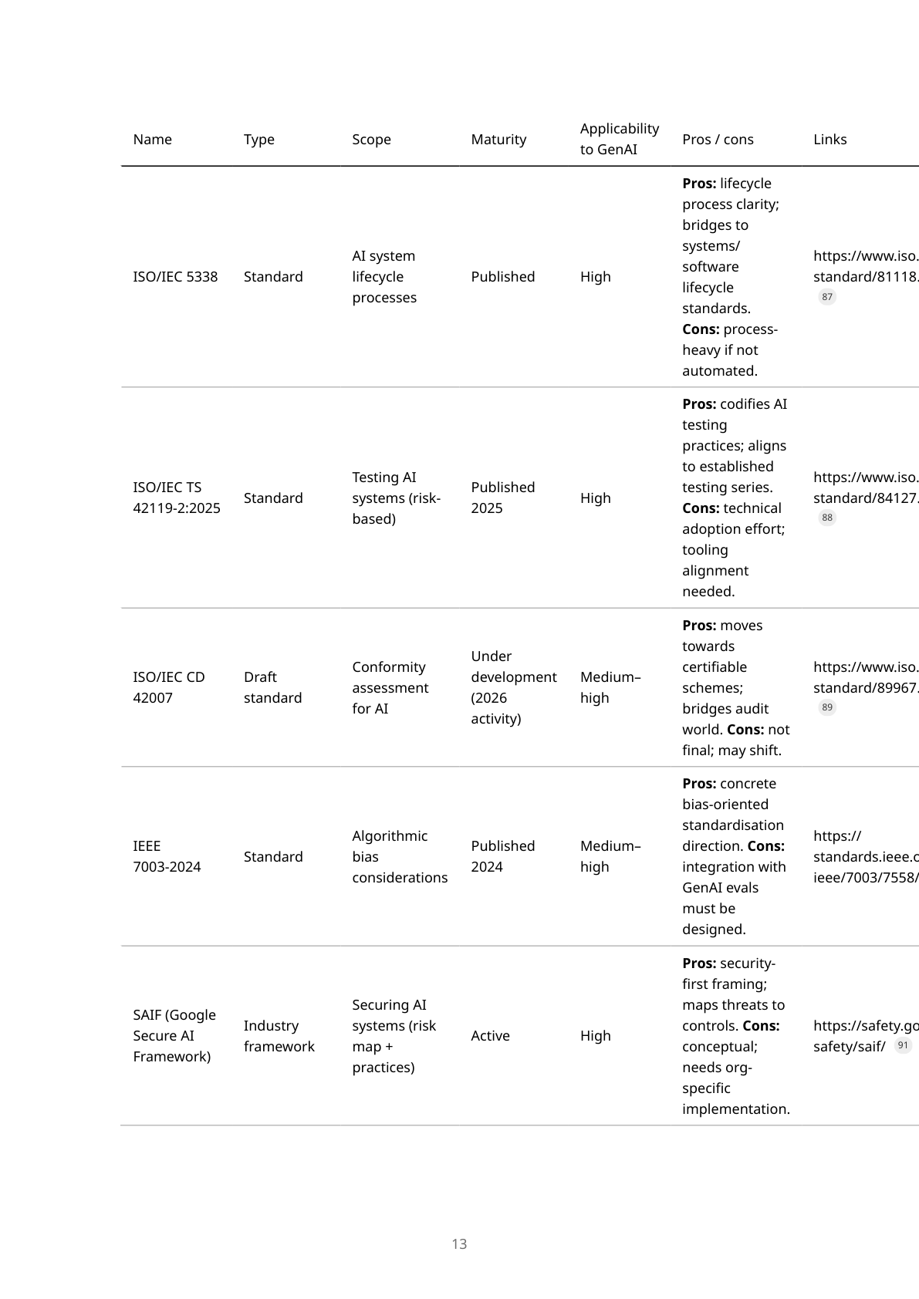
Appendix B — GenAI governance report (page 13/23)
AI Governance — Microsoft Stack + GenAI
92/102

Slide 93
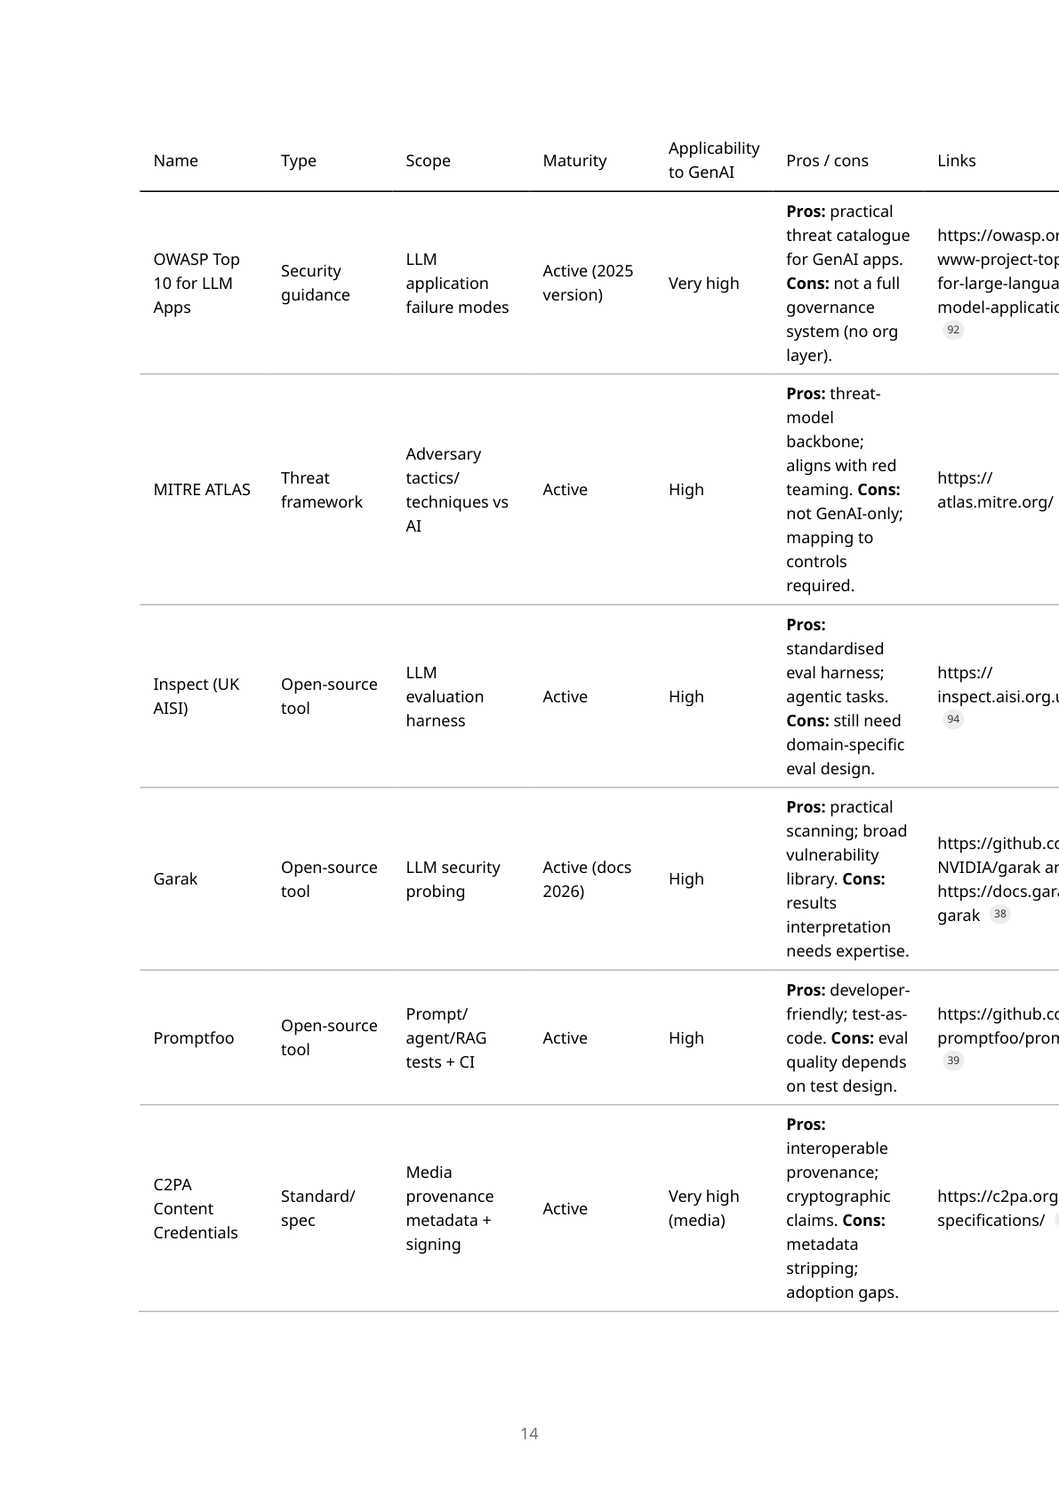
Appendix B — GenAI governance report (page 14/23)
AI Governance — Microsoft Stack + GenAI
93/102

Slide 94
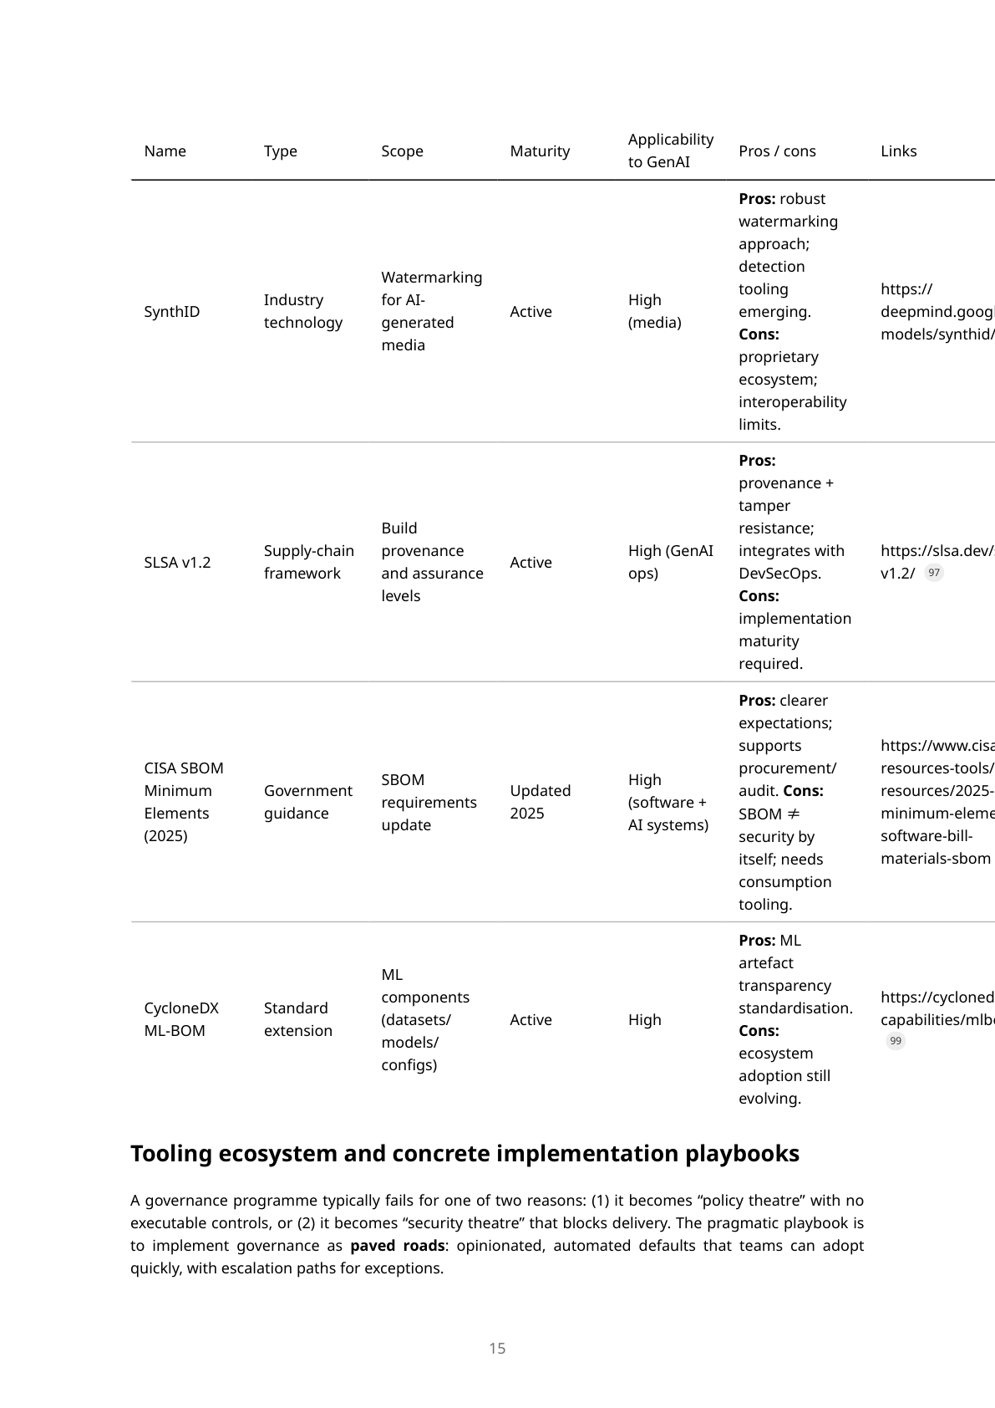
Appendix B — GenAI governance report (page 15/23)
AI Governance — Microsoft Stack + GenAI
94/102

Slide 95
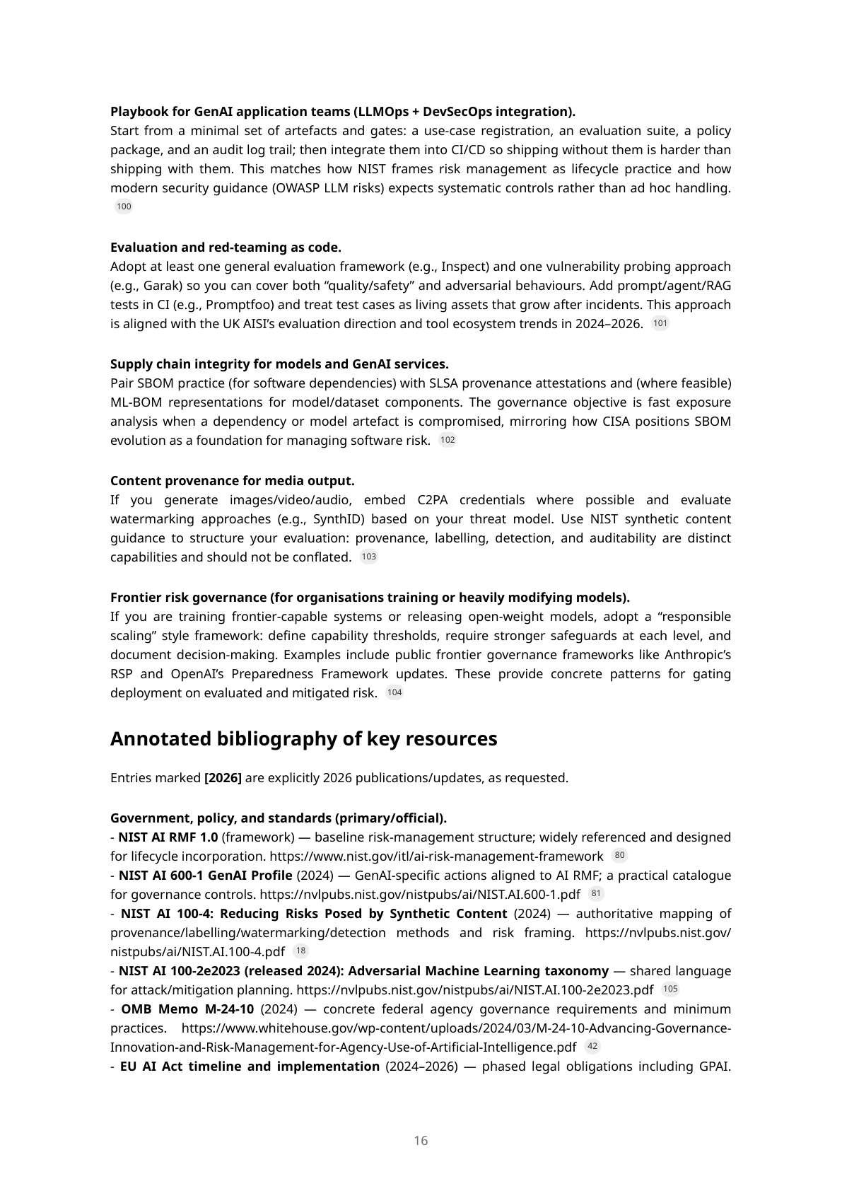
Appendix B — GenAI governance report (page 16/23)
AI Governance — Microsoft Stack + GenAI
95/102

Slide 96
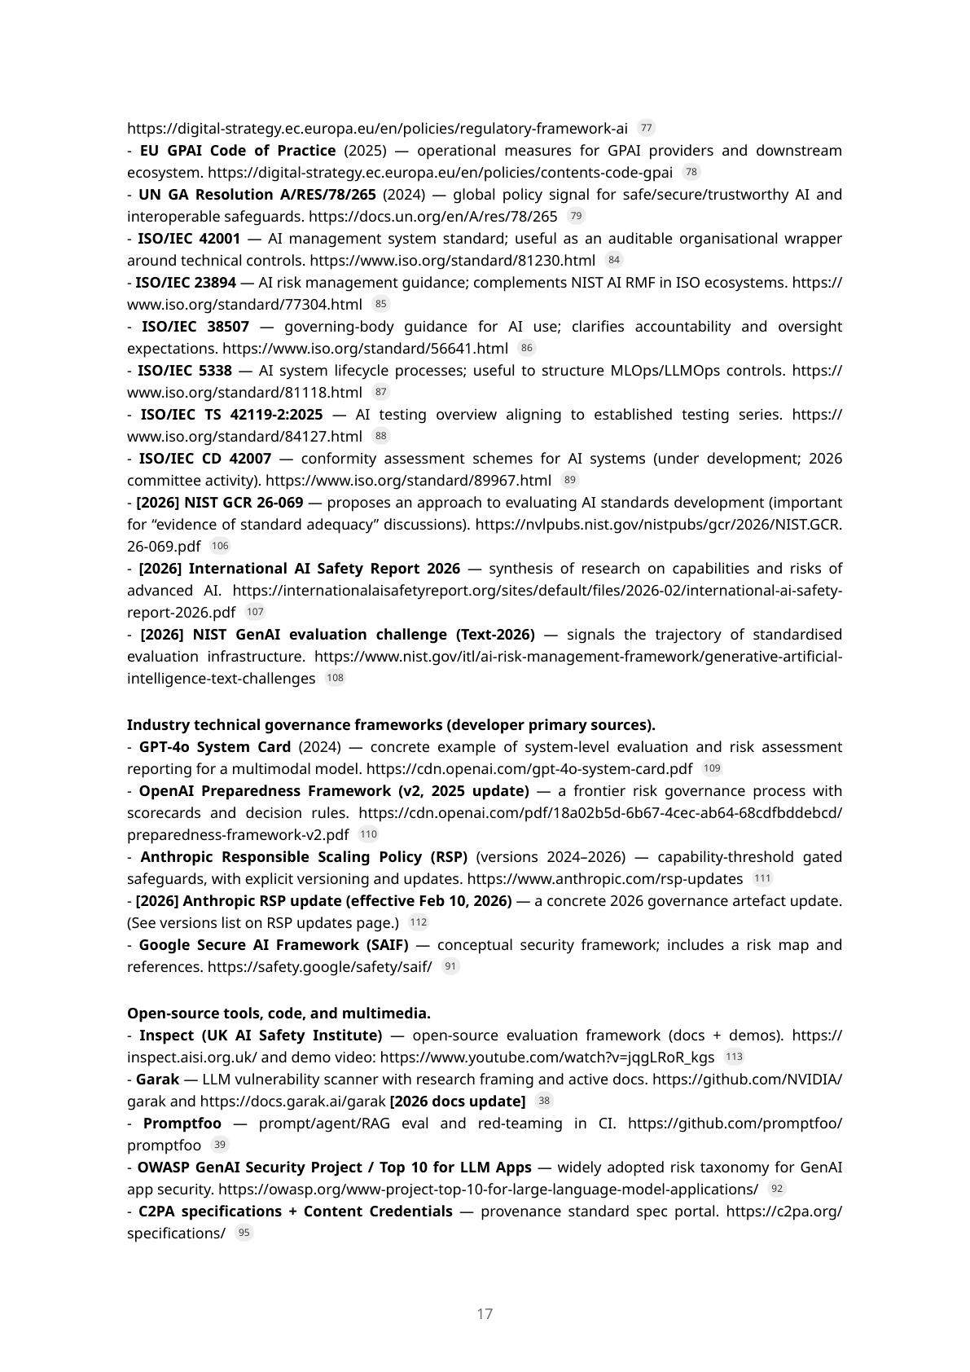
Appendix B — GenAI governance report (page 17/23)
AI Governance — Microsoft Stack + GenAI
96/102

Slide 97
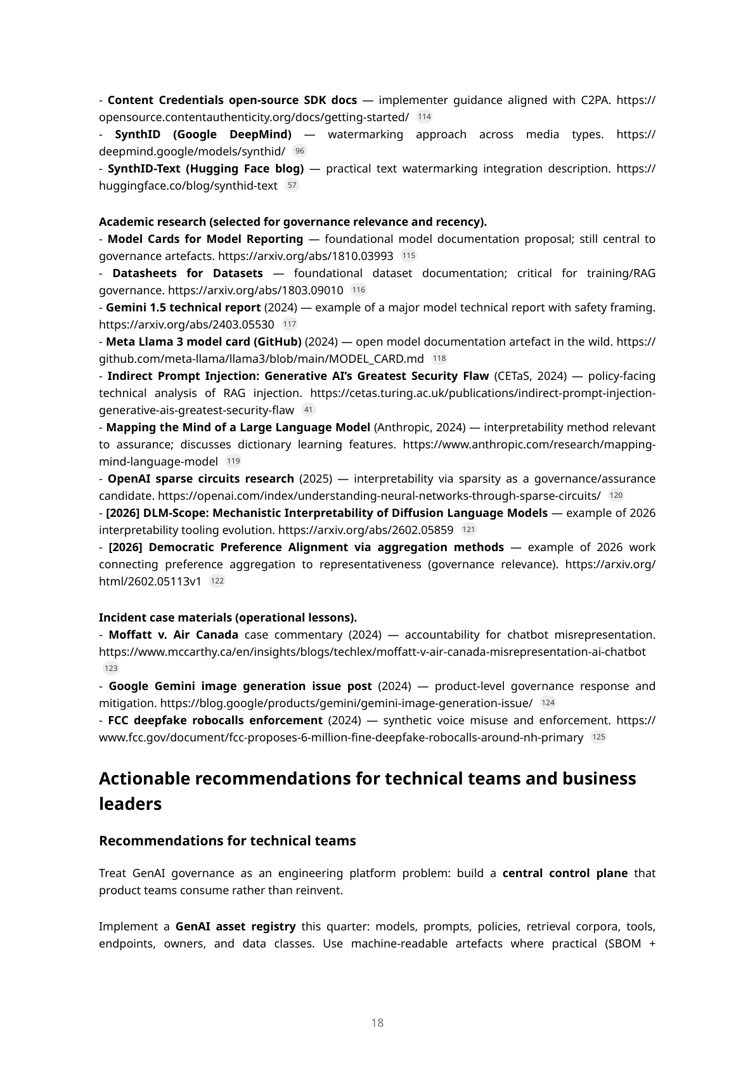
Appendix B — GenAI governance report (page 18/23)
AI Governance — Microsoft Stack + GenAI
97/102

Slide 98
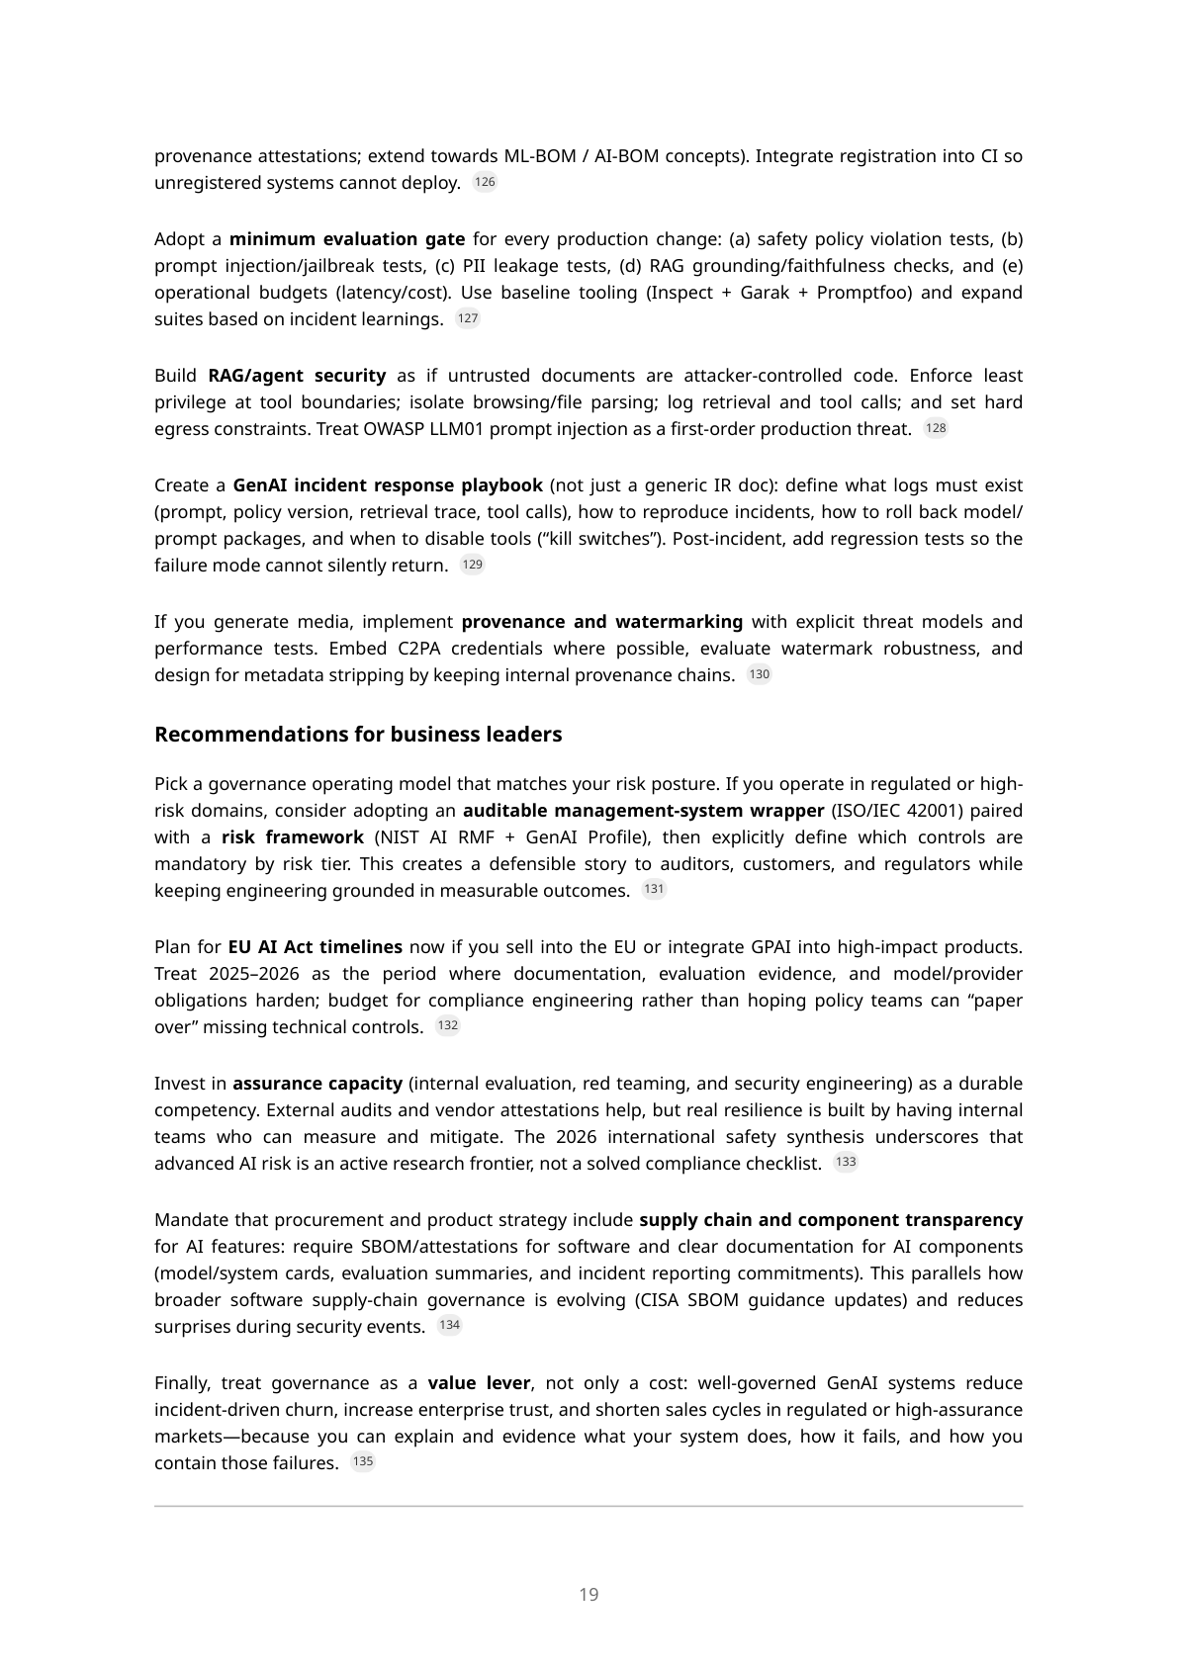
Appendix B — GenAI governance report (page 19/23)
AI Governance — Microsoft Stack + GenAI
98/102

Slide 99
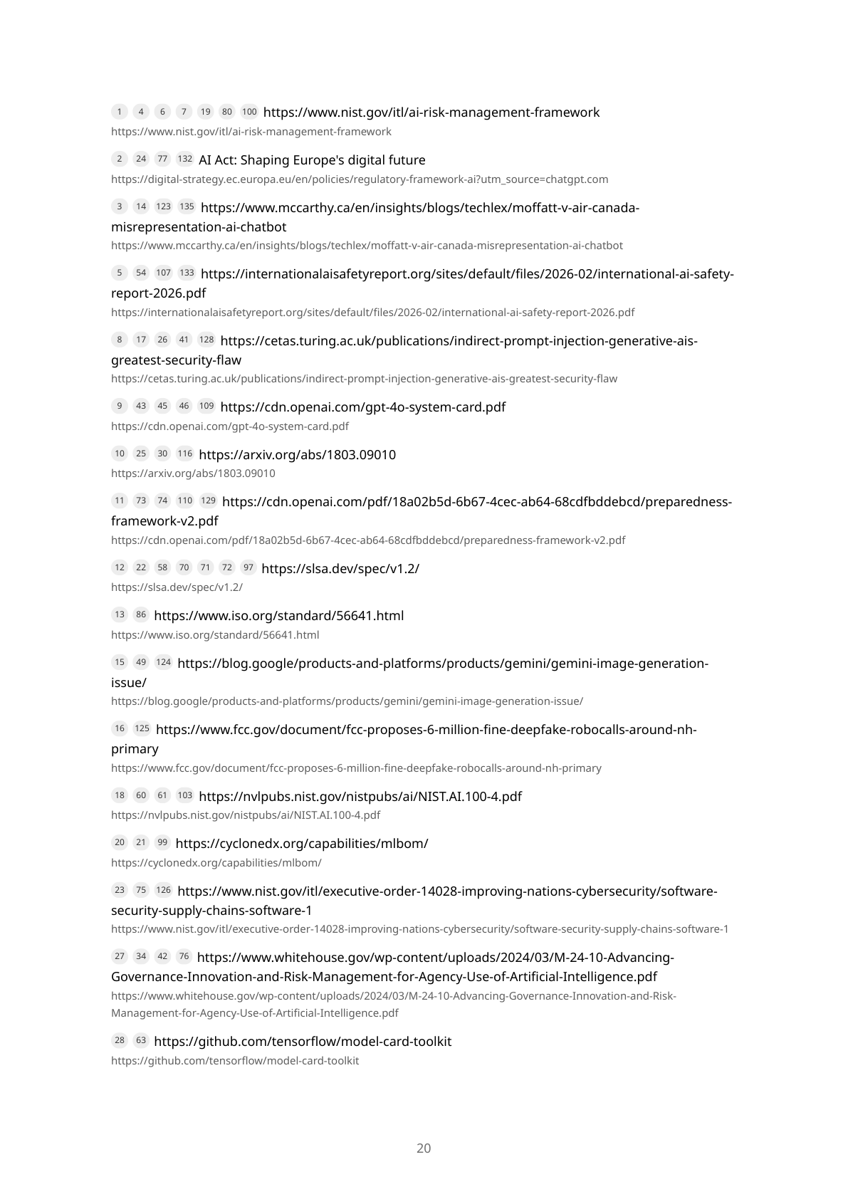
Appendix B — GenAI governance report (page 20/23)
AI Governance — Microsoft Stack + GenAI
99/102

Slide 100
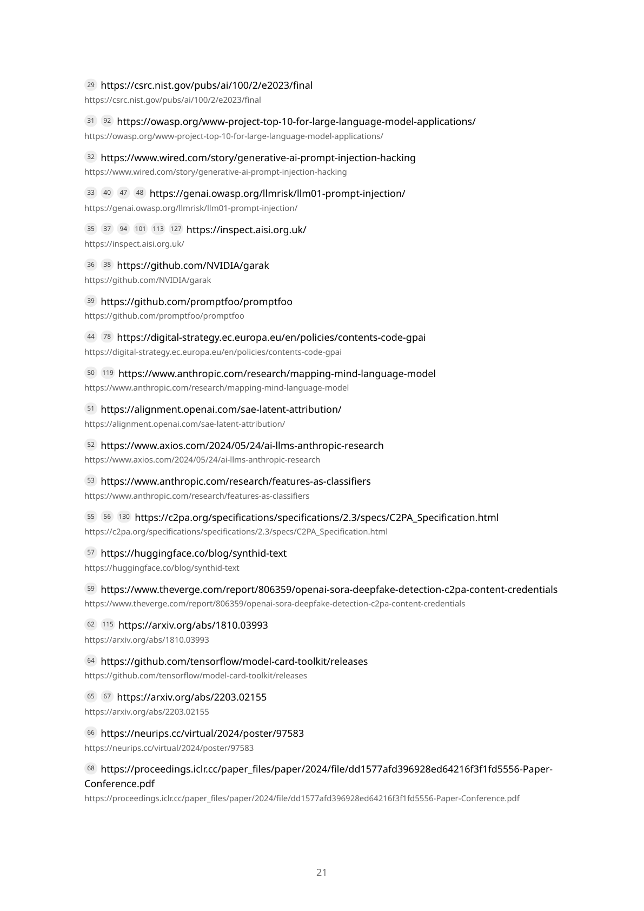
Appendix B — GenAI governance report (page 21/23)
AI Governance — Microsoft Stack + GenAI
100/102

Slide 101
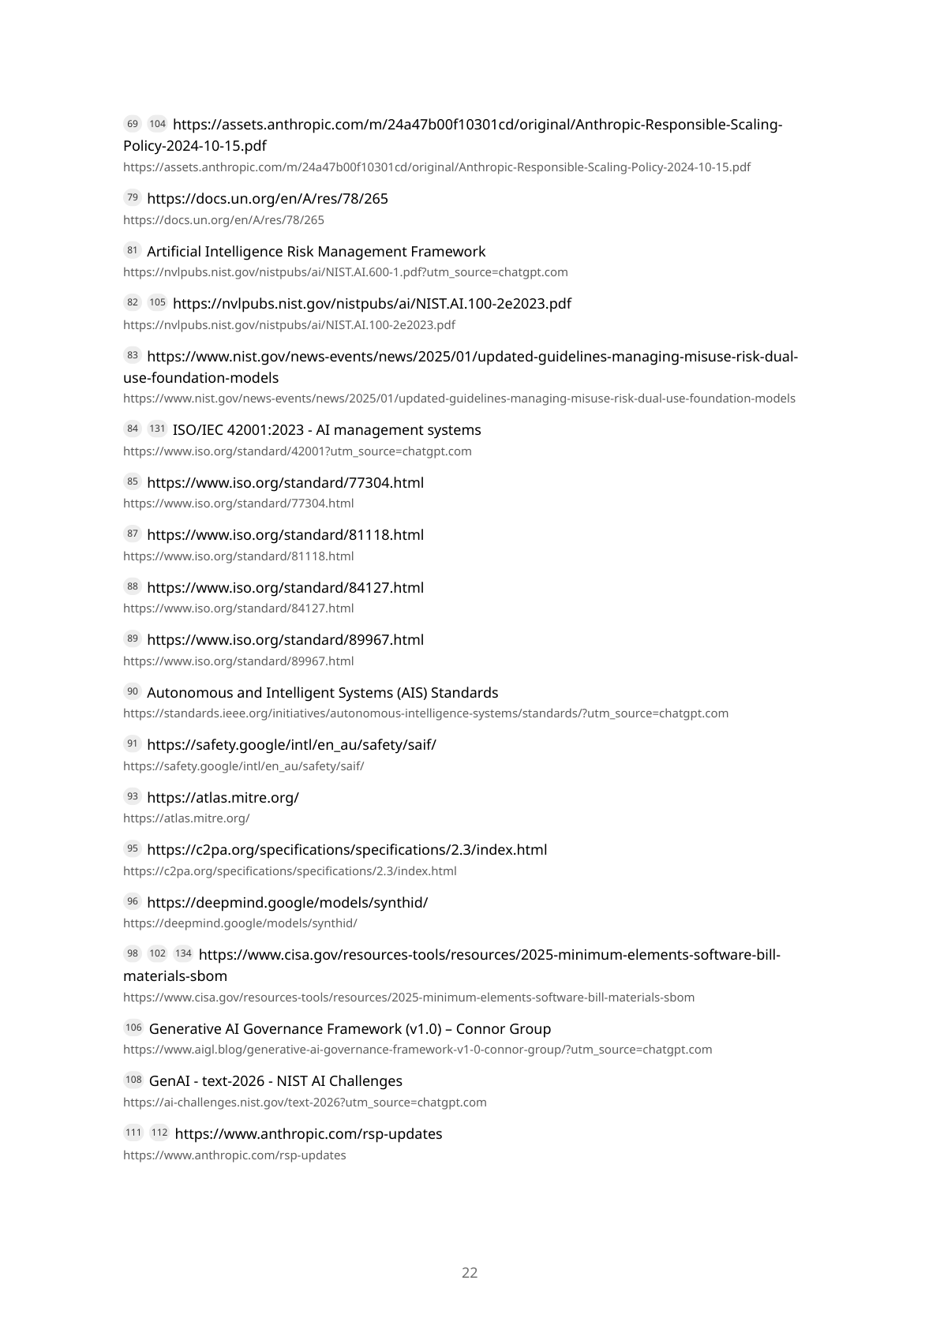
Appendix B — GenAI governance report (page 22/23)
AI Governance — Microsoft Stack + GenAI
101/102

Slide 102
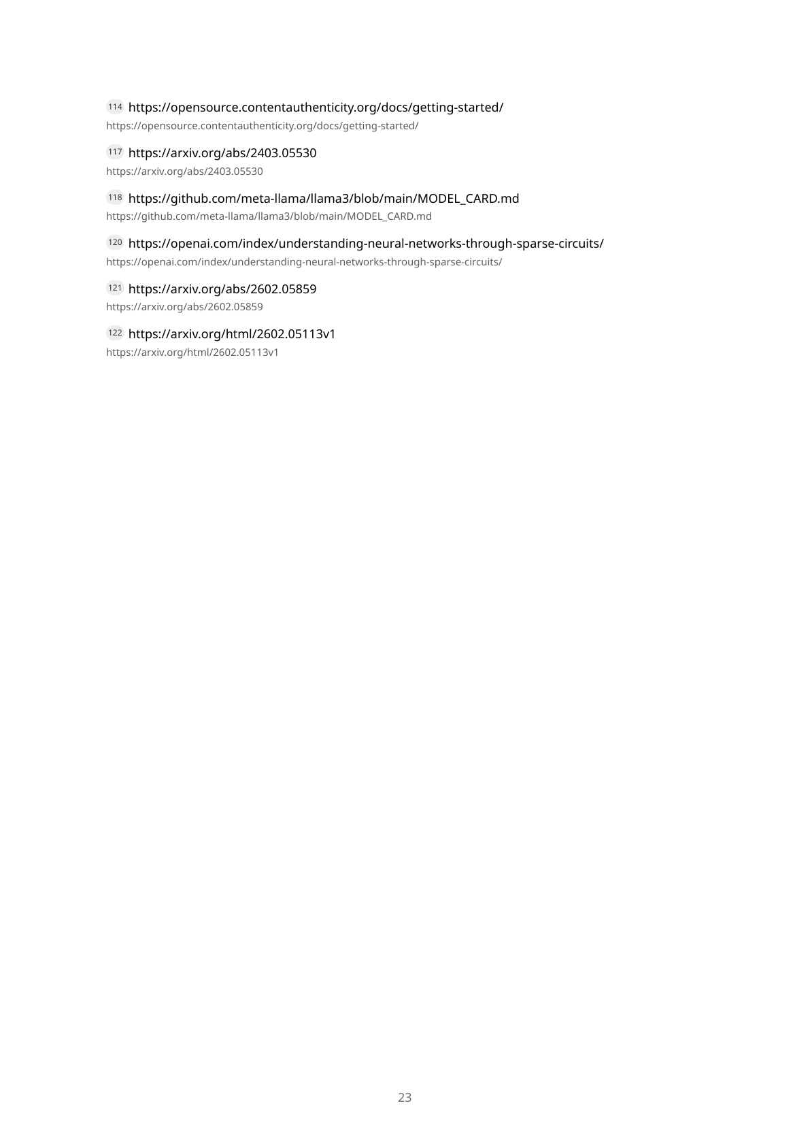
Appendix B — GenAI governance report (page 23/23)
AI Governance — Microsoft Stack + GenAI
102/102

